Slide 1


Slide 2
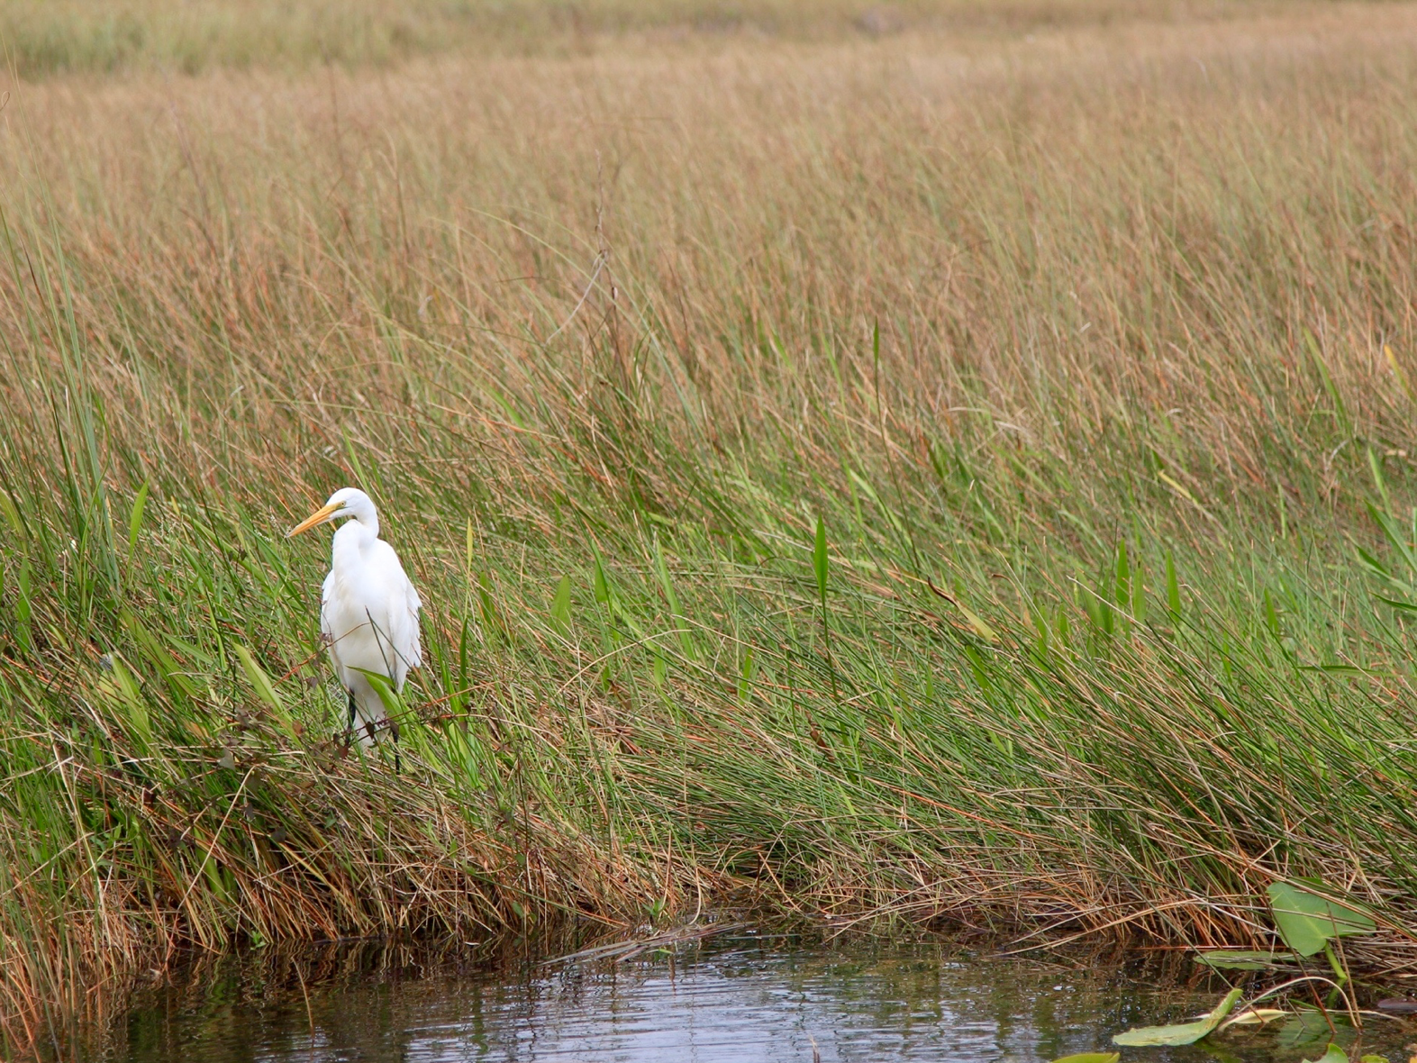



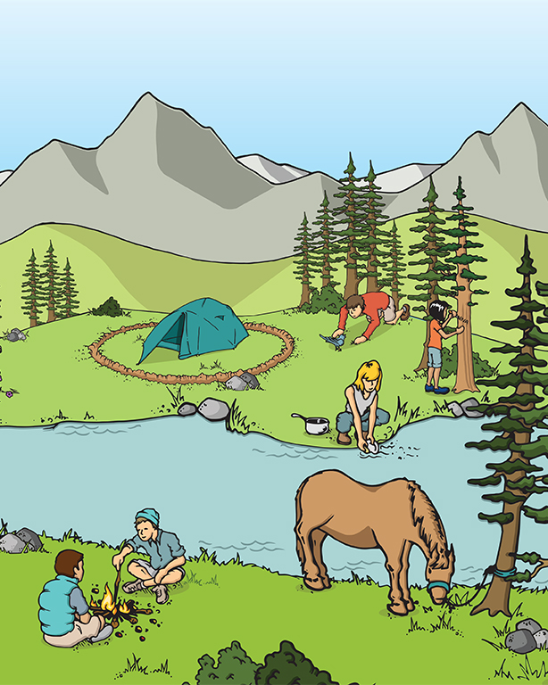

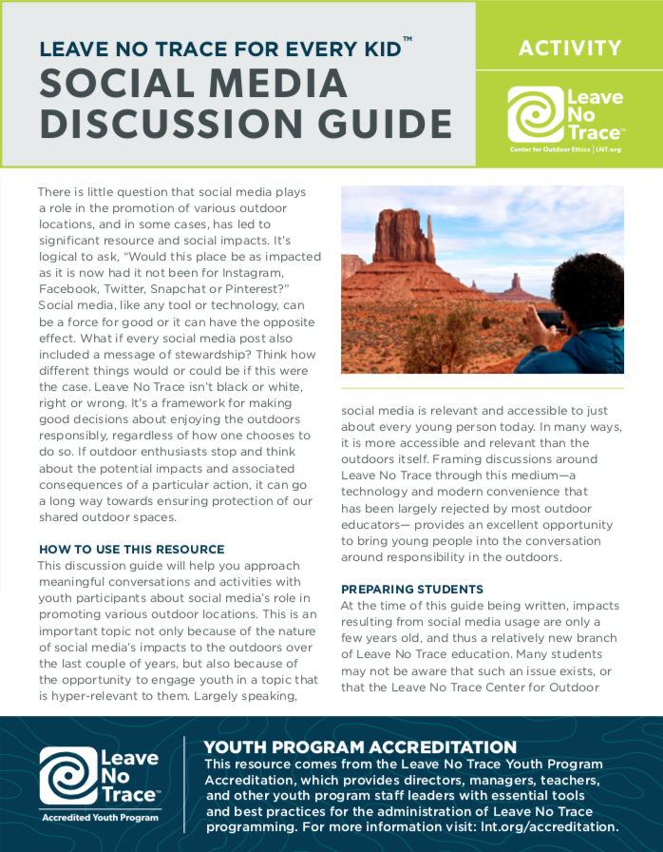
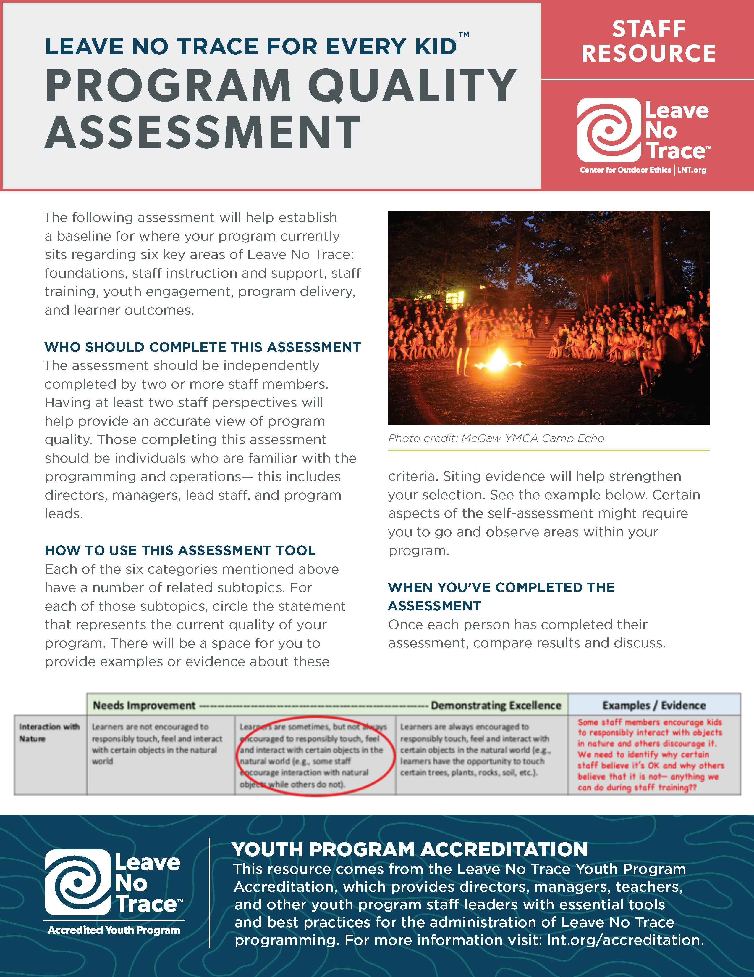
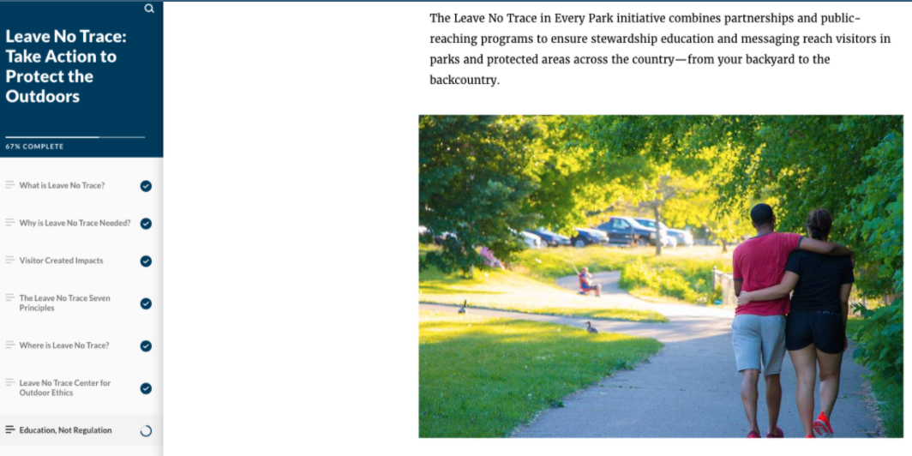
Youth Education
Curriculum & Resources

Slide 3
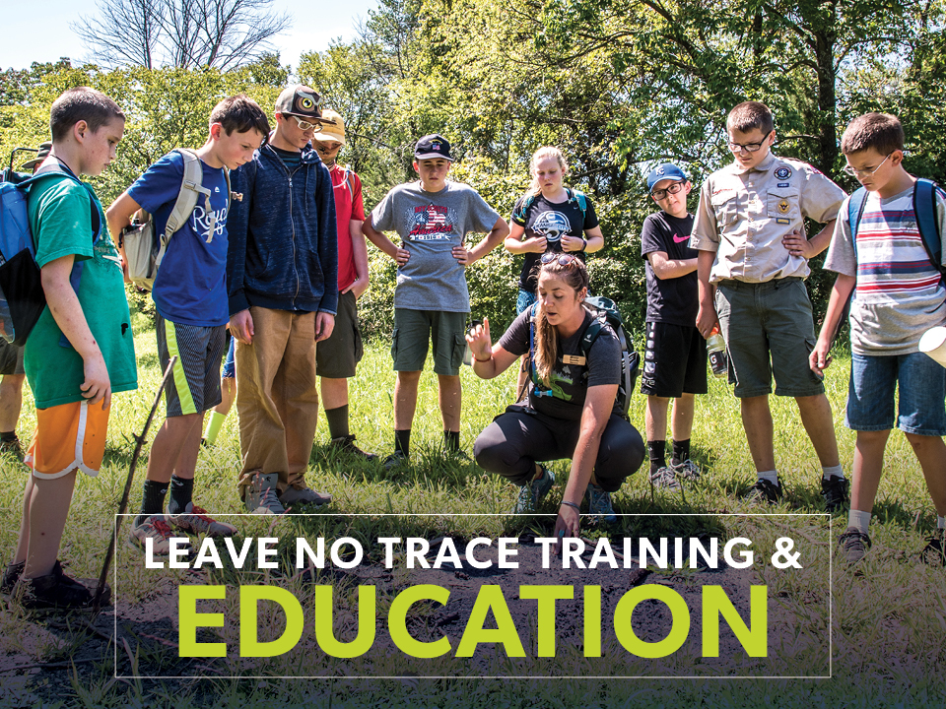

Slide 4
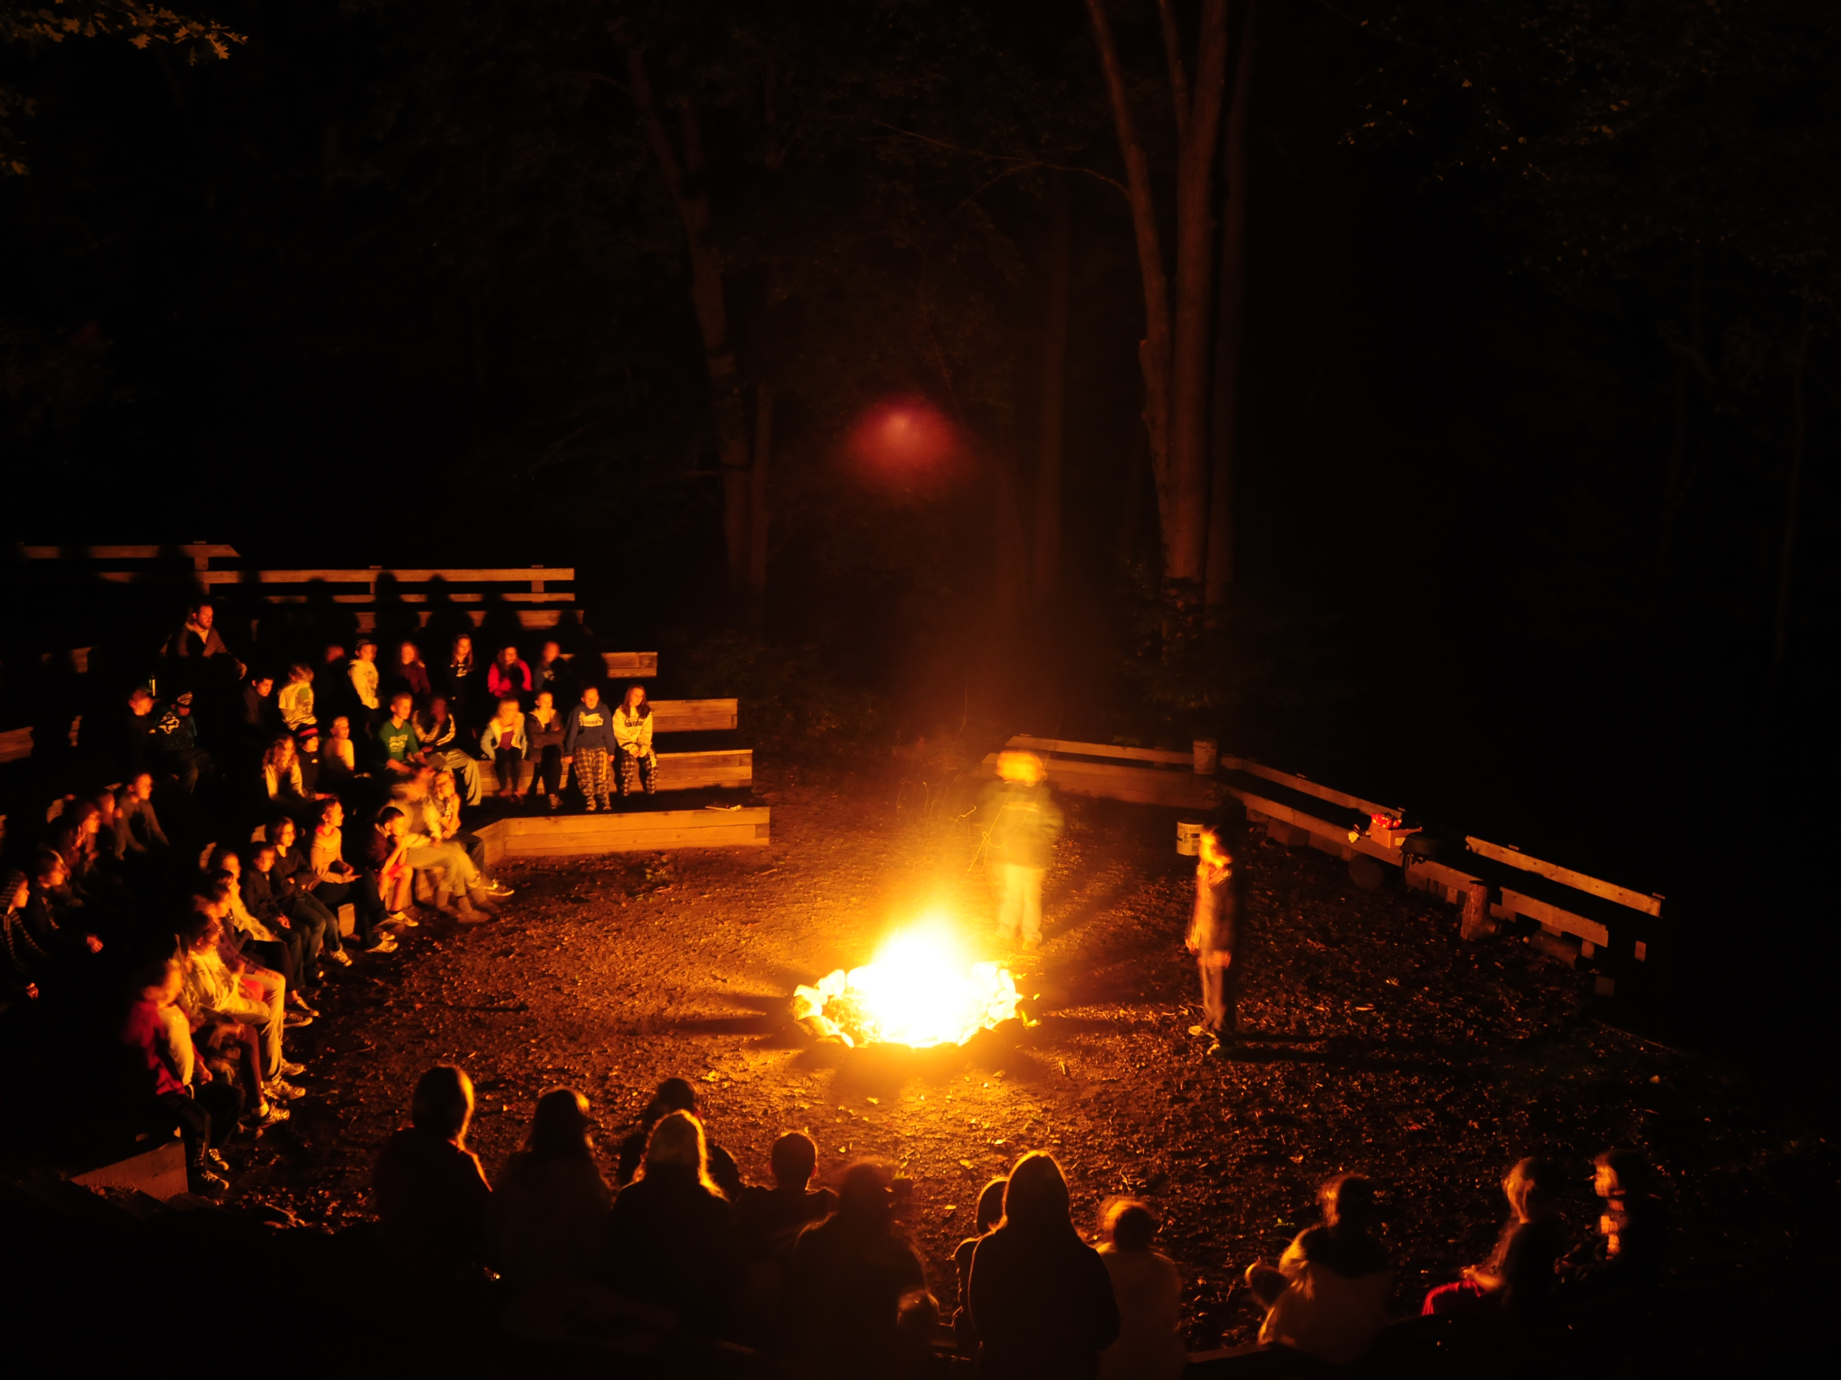
How Do
Scouts Develop
Values?
Talk about values
Teach about values
Practice & model values
Celebrate & recognize values

Slide 5
Talk about
Teach about
Practice & model
Celebrate & recognize
How Do
Scouts Develop
Values?
Leave No Trace
Leave No Trace
Leave No
Trace

Slide 6
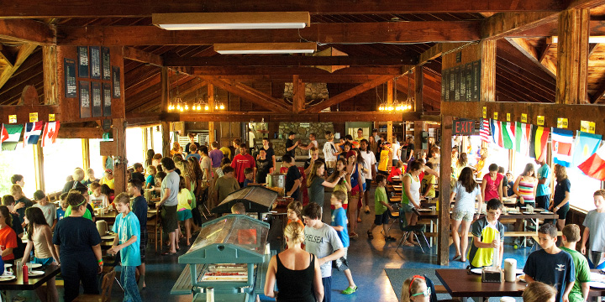
Dinning hall photo

Slide 7
Youth Education
Curriculum & Resources
The Leave No Trace Youth Program Accreditation™

Slide 8
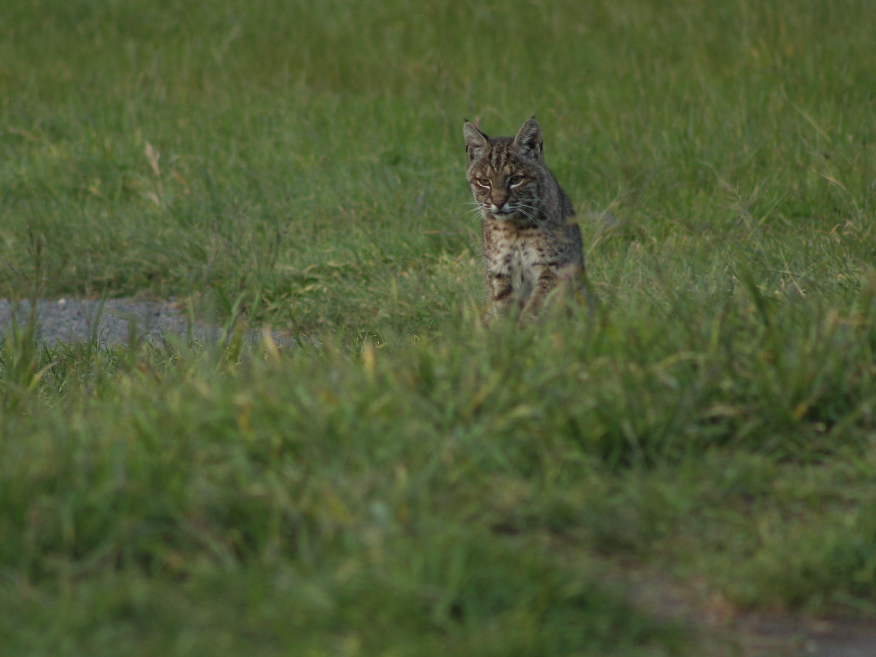

Bigfoot’s Playbook
38 Activities
Ages: 6 – 12+
Easy to use with download materials
Reflection and debrief

Slide 9
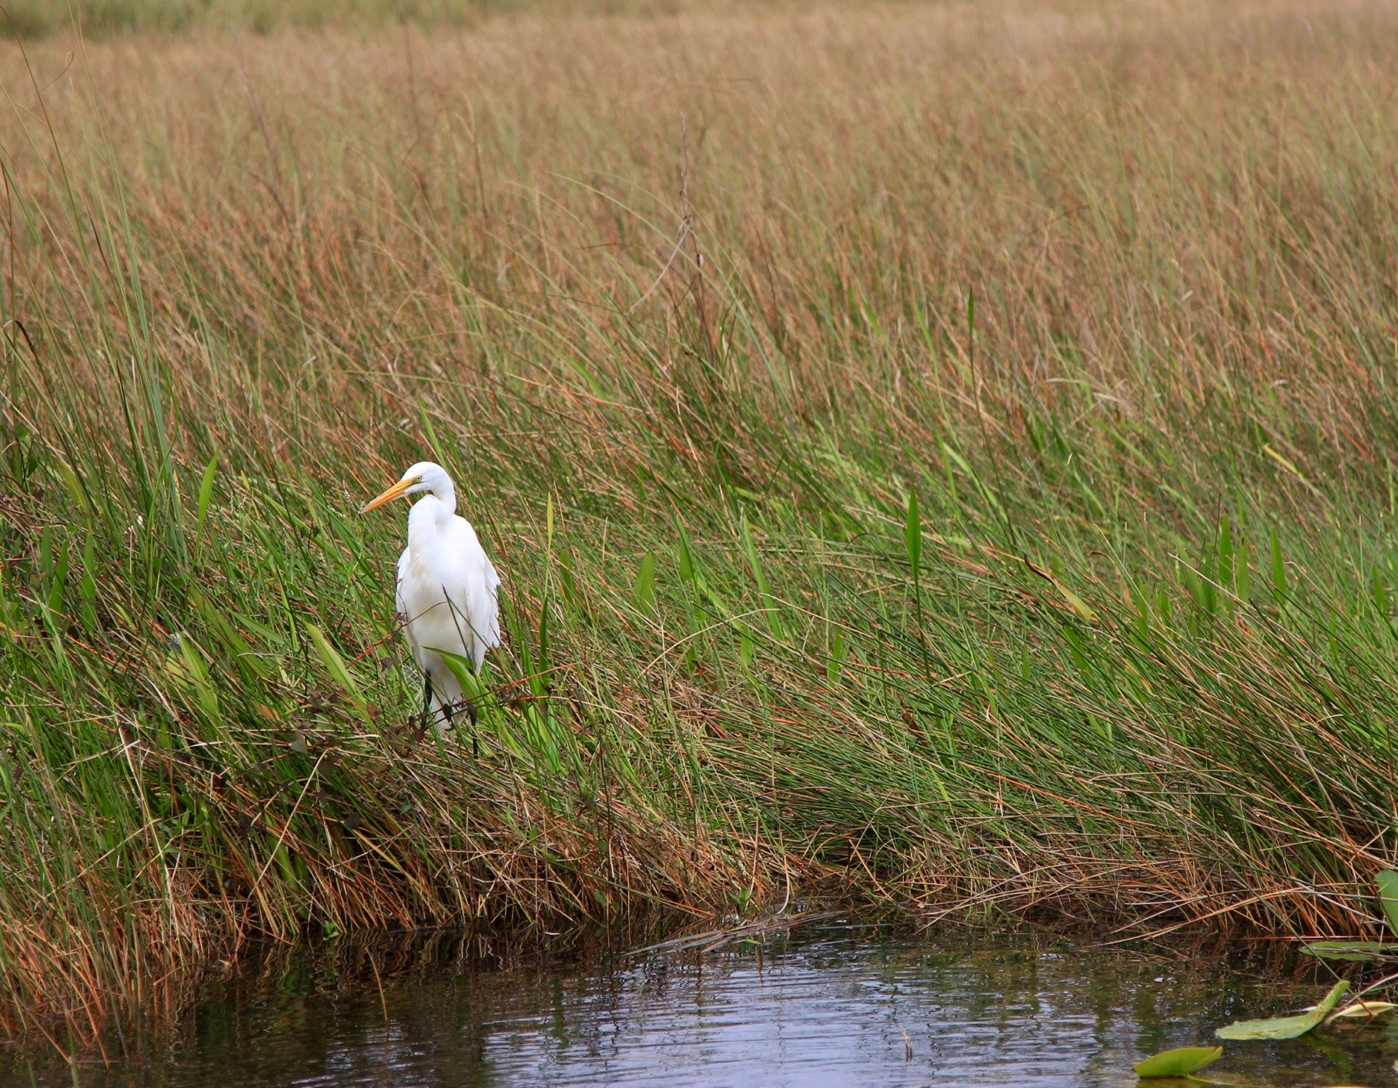















Tigers in the Wild
Backyard Jungle
Call of the Wild
Paws on the Path
Spirit of the Water
Webelos
Walkabout
Bear Necessities
Trash Timeline
Watch Your Step!
Leaf Collage
Hopscotch
Hug a Tree
Campfire Impacts
Impacts and Wildlife
Have a Sip
Firewood Gathering
Nest Challenge
Build a Fort
Okay vs No Way!
Ethics Game
Generation Game
Surface
Hopscotch
Durable Surface
Mystery
Outdoorsman
Scouting Adventure
Campsite Oh No’s
Ethics Game
Cumulative Impacts
Cumulative Impacts
Ethics Game
Campsite Oh-No’s
Leave No trace Question Ball
Okay vs. No Way
Are You Ready

Slide 10
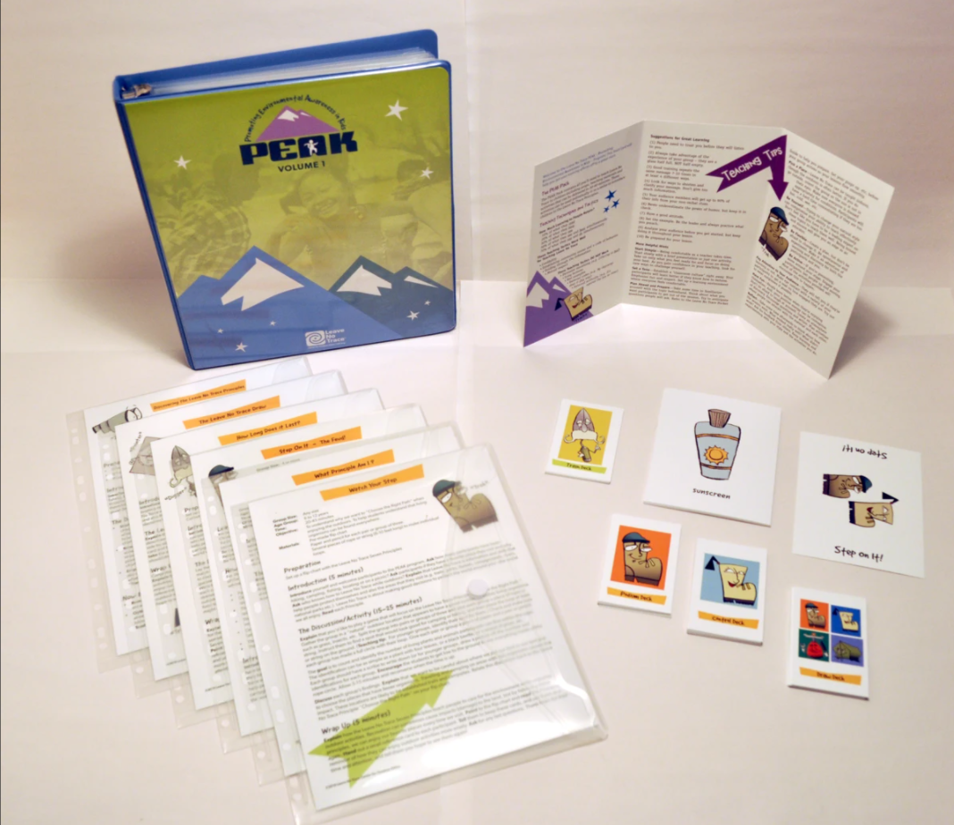

Slide 11


Slide 12

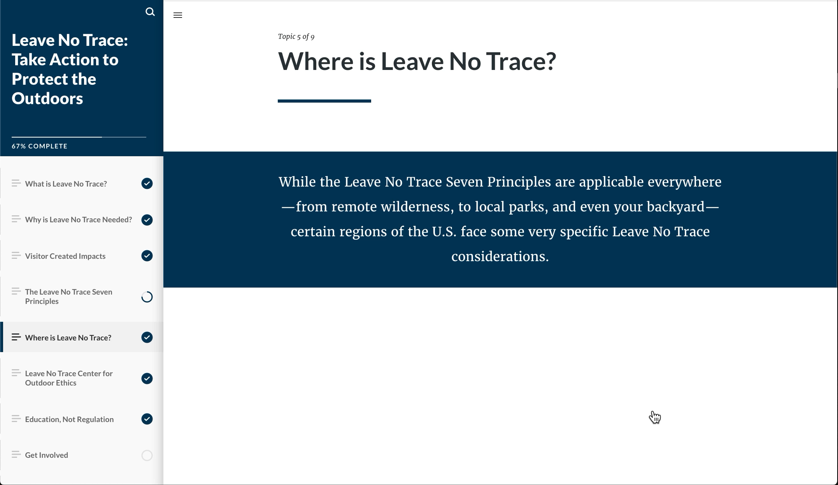
Online and Digital
LEARNING

Slide 13
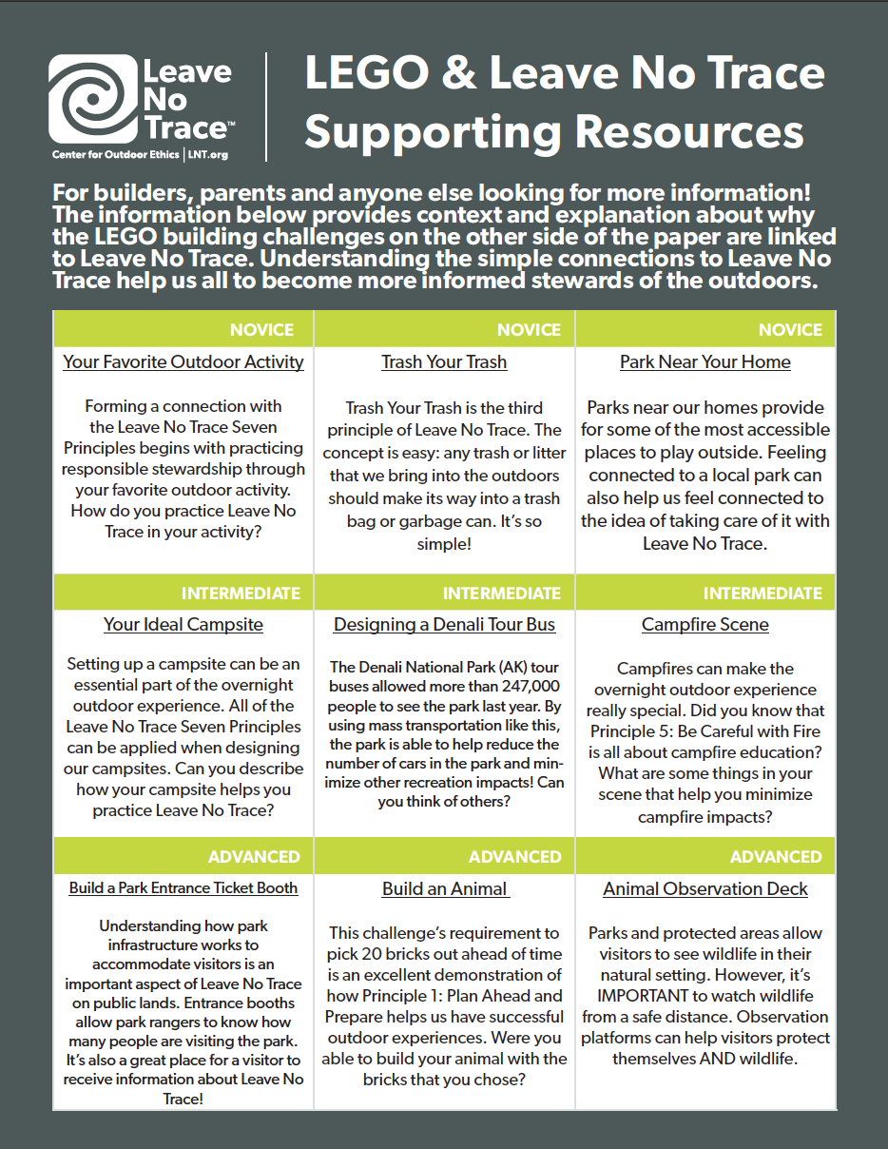
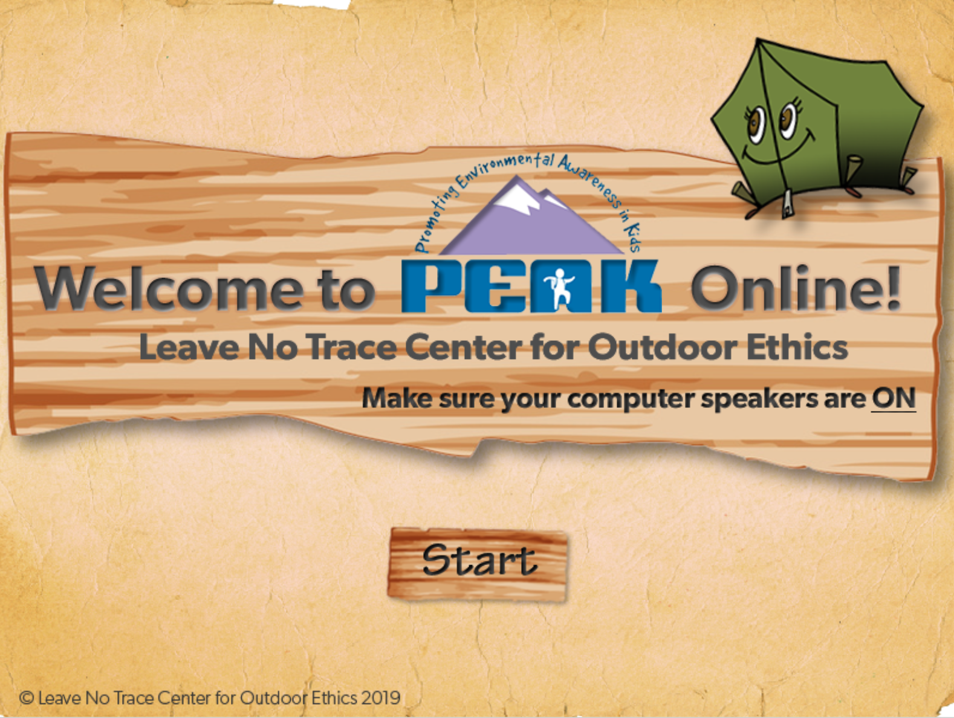
Online and Digital
LEARNING

Slide 14

SOCIAL MEDIA + STEWARDSHIP
CURRICULUM
Engaging and new way to learn about Leave No Trace
Technology is an under utilized education mechanism for reaching teenagers
Educator resource to facilitate activities

Slide 15



SOCIAL MEDIA + STEWARDSHIP
CURRICULUM
Library of curated articles and media that explore the impact issues
Activities that allow young people to interpret responsibility for the outdoors and social media context
21st Century Skills:
critical thinking
collaboration
creativity and imagination
accessing and analyzing information

Slide 16

LEGO + LEAVE NO TRACE
CURRICULUM

Slide 17
YOUTH PROGRAM
ACCREDITATION
The Leave No Trace Youth Program Accreditation™

Slide 18

YOUTH PROGRAM
ACCREDITATION
www.LNT.org/accreditation

Slide 19
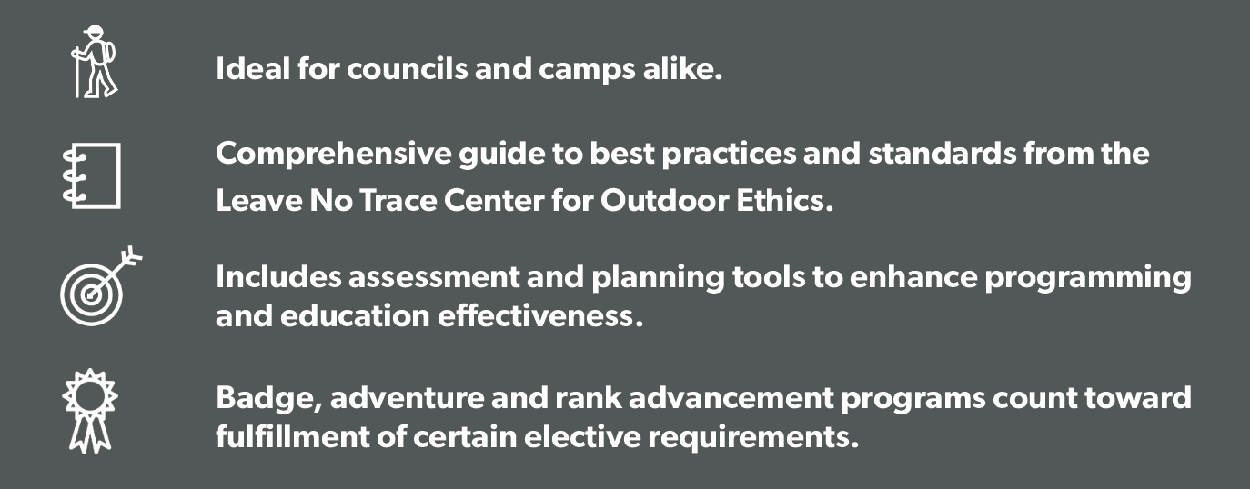
YOUTH PROGRAM
ACCREDITATION
www.LNT.org/accreditation

Slide 20
YOUTH PROGRAM
ACCREDITATION
Alignment with NCAP Standards
PD-101
PD-104
PD-107
RP-252
RP-253
RP-460
PS-211
SQ-412
SQ-410
General Program Design
Venturing / Sea Scout Program Design
Outdoor Ethics
Nature Trail or Exhibit
Outdoor Ethics Training
Trek Staff Outdoor Ethics Training
Nature and Conservation Programs
Other Program Staff Qualifications
Trek Leadership and Staff
The Leave No Trace Youth Program Accreditation™
www.LNT.org/accreditation

Slide 21
YOUTH PROGRAM
ACCREDITATION
Council
Day Camp #1
Day Camp
#2
Overnight Camp
www.LNT.org/accreditation

Slide 22
Youth Education
Curriculum & Resources
The Leave No Trace Youth Program Accreditation™

Slide 23


