Slide 1
Leave No Trace
Current Programs

Slide 2
The Leave No Trace Organization
MISSION
  Using the power of science, education and stewardship, Leave No Trace is on a mission to ensure a sustainable future for the outdoors and the planet.
  No matter where or why you get outside, it’s yours to protect.
  It’s Your Nature.
VISION
  To sustain healthy, vibrant natural lands for all people to enjoy, now and into the future. Every person who ventures outside puts Leave No Trace practices into action.

Slide 3
What Do They Do?
Protect the outdoors by teaching people to enjoy it responsibly
Most widely accepted outdoor ethics program used on public lands.
Targeted education, research and outreach, ensuring the long-term health of our natural world.
Deliver cutting-edge education and research to millions of people every year.
Leave No Trace is at work in all 50 United States and in countries across the globe.

Slide 4
Leave No Trace
STRATEGIES
  PEOPLE – Make Leave No Trace relevant and accessible for all people who spend time outside
  LANDS – Make Leave No Trace prominent, relevant and accessible in the outdoors
  COLLABORATION – Ensure all outdoor programs/organizations embrace and champion Leave No Trace
  Organizational SUSTAINABILITY — an organization that is thriving financially, broadly supported and coupled with strong leadership to ensure our ability to pursue our mission into the future.
GOALS
  Leave No Trace in Every Park.
  Leave No Trace for Every Kid.
  Every person who ventures outside puts leave no trace practices into action.

Slide 5
Current Programs
Training for Everyone
Traveling Trainers
Leave No Trace in Every Park
Hot Spots
Big Foot
Leave No Trace For Every Kid
PEAK
Tech Tips
State Advocates
e-Newsletter
Blog
Membership
International

Slide 6
Leave No Trace for Everyone
Announced July 18
Training Structure Changes
  Instructor Track – Certification
  Recreational Track, New Skills Course
New Online Leave No Trace 101 Course
  Heavily publicized on Social Media
More Coming

Slide 7
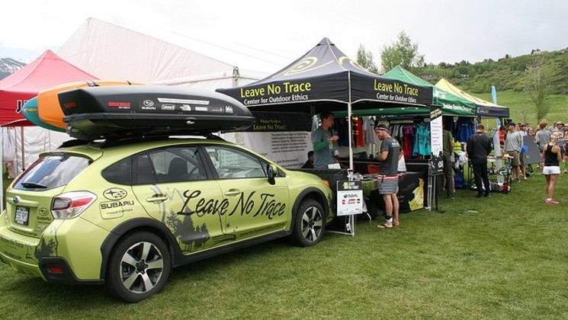
Traveling Trainers
Partnered with Subaru
Provide onsite training and outreach across the country
  Schools
  Parks
  Communities
  Hot Spots
4 pairs, calendar set 1 year out
Bigfoot costume

Slide 8

Leave No Trace in Every Park
Public Lands initiative
Public education initiatives
Interpretive materials
Staff and volunteer training
Onsite education
Junior Ranger programs
Site recognition
Community events

Slide 9

Spotlight Program
(formerly Hot Spots)
Nominated by members
A week-long visit by Traveling Trainers
Training workshops for volunteers, employees, and key members of the community
Locally-tailored programs

Slide 10
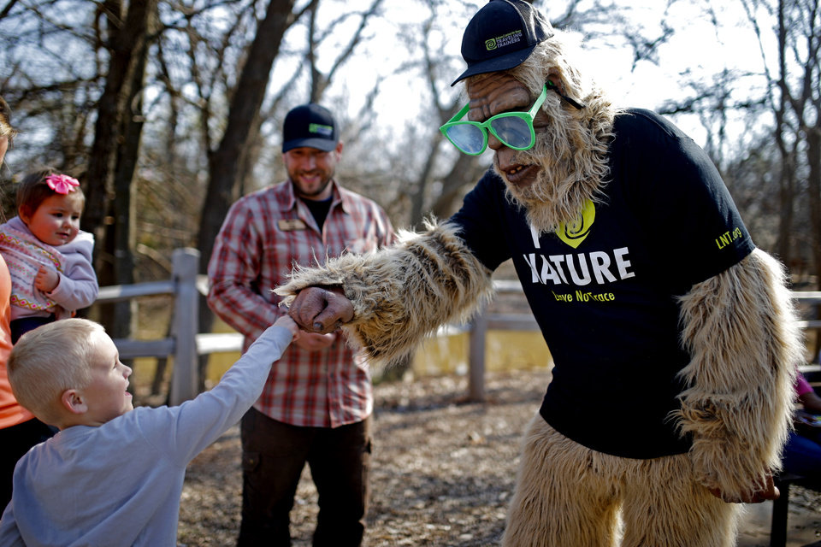


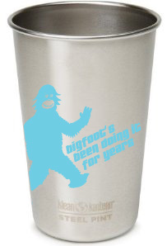
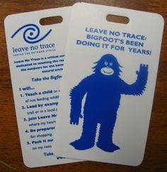
Big Foot
Leave No Trace, Big Foot’s been doing it for years
Big Foot Challenge

Slide 11


Leave No Trace For Every Kid
Engages youth in programs where the outdoors serves as a backdrop for their development
Big Foot’s Playbook
Camp Accreditation

Slide 12
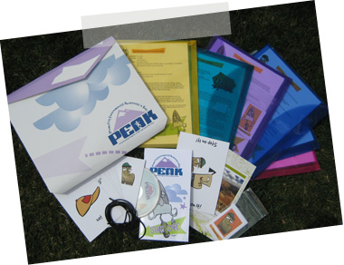
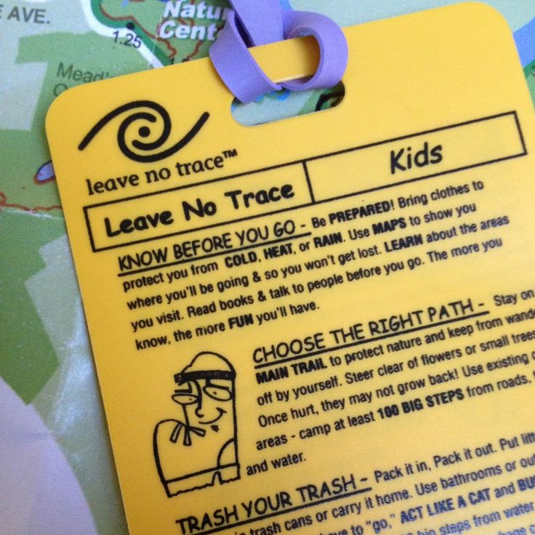


PEAK
Promoting Environmental Awareness in Kids
Partnered with REI
Youth pack and teen pack
PEAK Principles
PEAK online

Slide 13



Tech Tips
Partnered with Keen Footwear
Visually relay information

Slide 14
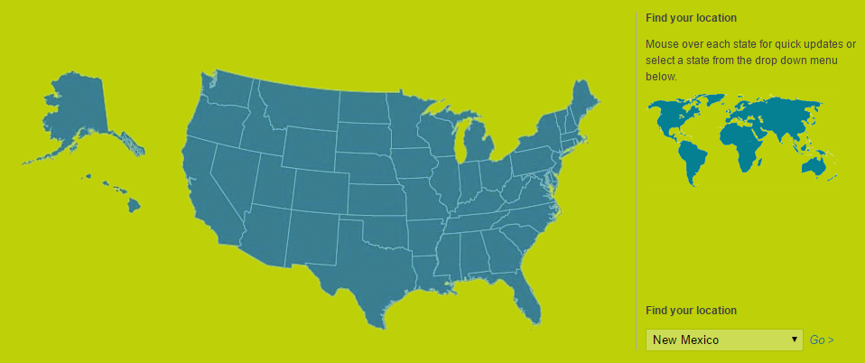
State Advocate
Coordinate outreach
Build alliances
Provide education and training
Get a 45% discount on material

Slide 15

Notes:
Leave No Trace has multiple strategies to reach people.

Slide 16
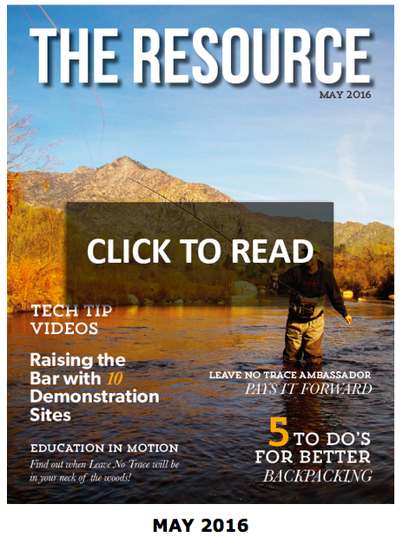
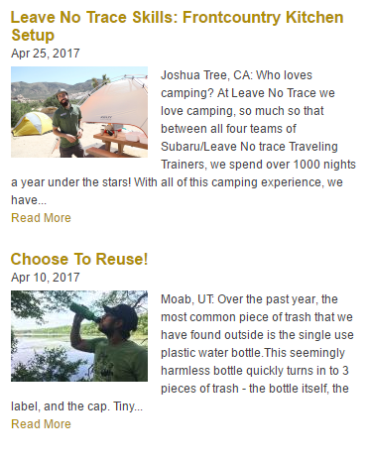
e-Newsletter and Blog
The Resource
  Success Stories
  Tips
  Research
  Where your donations go
Blog
  Skills
  Best practices
  Videos
  Program updates

Slide 17
Membership
Individual
  $0.81/$1 goes to outreach and Education
  Member benefits
  10% Store discount
Corporate
  Logo use
  Social sharing
  newsletter
Community
  Businesses
  School
  Local parks

Slide 18

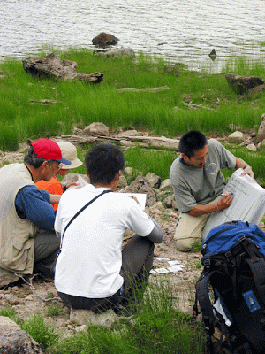
International Program
Support to over 60 countries
    Over a dozen translations
    Educational tools
    Partnerships
    Support visits
Leave No Trace Australia
Leave No Trace Canada/
Sans Trace
Leave No Trace Ireland
Leave No Trace New Zealand
67 countries with Scouting!

Slide 19
Questions?

Slide 20
Prepared by
Joshua Lamothe
Revised: May 2017, Aug 2017, June 2022, July 2023
Sources:
www.lnt.org
Notes:
Guide to Advancement - http://www.scouting.org/filestore/pdf/33088.pdf
2015-2016 Cub Scout Requirements - http://www.scouting.org/filestore/program_update/pdf/Appended%20Requirements.pdf

