Slide 1


LEAVE NO TRACE SOCIAL SCIENCE:
HUMAN DIMENSIONS OF
NATURAL RESOURCES
© Leave No Trace
Notes:
We conduct research to help Leave No Trace hone new, effective ways to educate the public about sustainable recreation and enjoyment in the outdoors, and how to most effectively protect public lands:

Slide 2
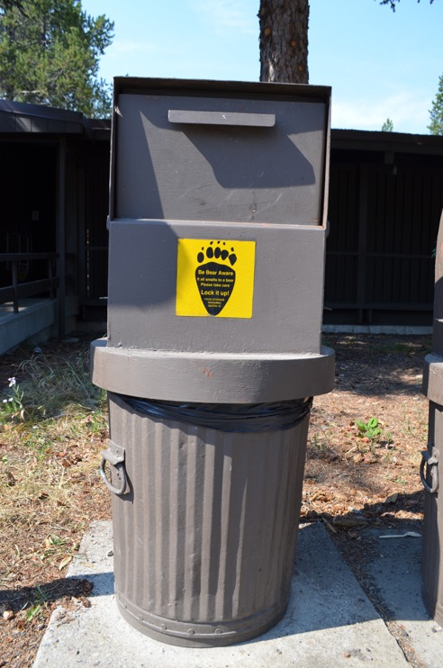

THE NEED FOR RESEARCH
For most park and protected area managers, balancing the protection of parks while at the same time providing quality recreational opportunities is an ongoing challenge.
As visitor use increases over time, the impact on visitor experience and ecological conditions also increases.
A specific concern for many park and protected area managers is recreation-related impact caused by visitors.

Slide 3

RESEARCH KEEPS US ON TRACK
Notes:
Systems approach – taking the big picture into account
Adaptive management – being able to adapt to changes quickly and effectively
Using data to our advantage
Understanding the recreating public

Slide 4
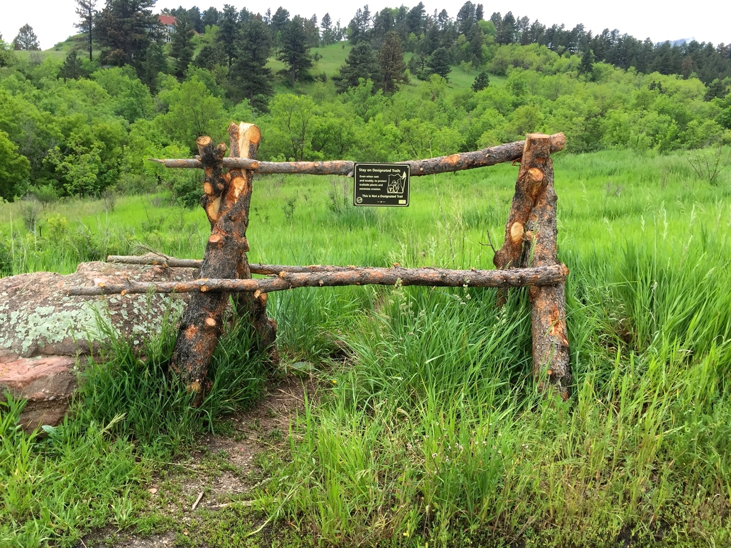
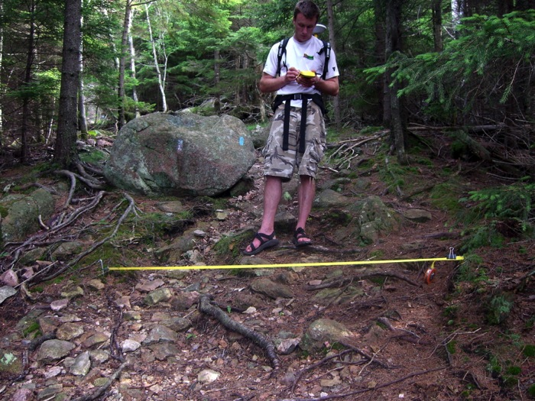
LEAVE NO TRACE RESEARCH FOUNDATION
Human Dimensions of Natural Resources (HDNR) research tells us about visitors’ perceptions, attitudes, behavioral intentions, and behaviors.
Recreation Ecology research tells us about recreation impacts and how they can be reduced by managers and visitors.
Notes:
The image on the left is from a study on the use of undesignated trails conducted on City of Boulder Open Space and Mountain Parks (Boulder, CO). This was a quasi-experimental design study, and this was one of four treatments used to determine its potential influence on the use of these undesignated trails.
The photo on the right is from Jeff Marion – location unknown (like the southern Appalachians).

Slide 5
HUMAN DIMENSIONS OF NATURAL RESOURCES RESEARCH
Environmentally-focused social science research is often referred to as human dimensions of natural resources, and involves:
  “The scientific investigation of the physical, biological, sociological, psychological, cultural and economic aspects of natural resource utilization at the individual and community level” (Ewert, 1996).
Federal land management agencies in the U.S. have historically approached management of impacts on lands used for recreation, “as a natural science endeavor requiring purely technical solutions.”
Technical solutions to resource management problems have been identified and are effective for some problems, but HDNR data is critical for understanding and influencing visitor behavior.
Notes:
As interest in Leave No Trace-focused human dimensions research grows studies are becoming more common and widespread.
Recent studies have been done in Grand Teton National Park, City of Boulder Open Space and Mountain Parks (CO), Yellowstone National Park, Shawnee National Forest (IL), Rocky Mountain National Park, Olympic National Park, Glacier National Park, Wyoming State Parks and Cumberland Island National Seashore, and many other locations.
Findings from these studies are important for Leave No Trace because they help create more effective education programs.

Slide 6
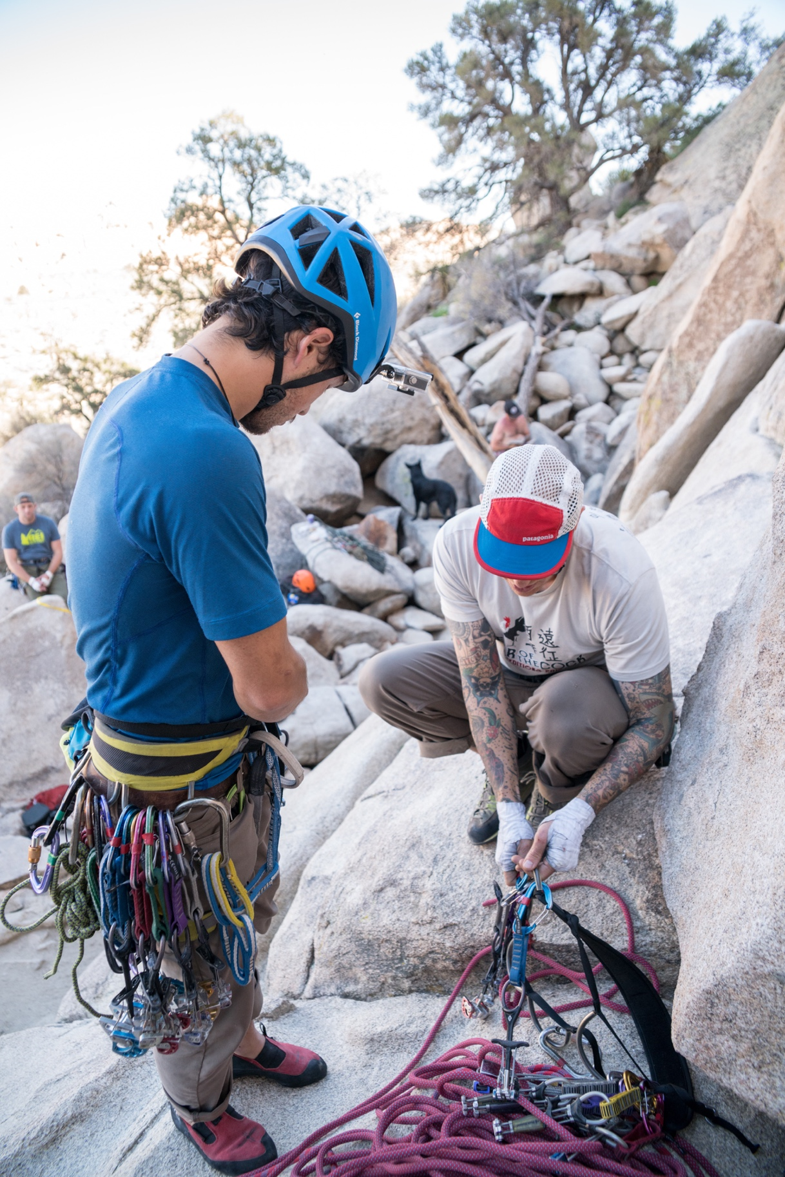
WHY SOCIAL SCIENCE DATA?
Park and protected area managers need to understand visitor attitudes, perceptions, and beliefs about impacts in parks in order to provide effective outreach and education.
Data can support enhancement of existing messages and development of new message to target visitor behavior and gain broader compliance.
Long-term success of educational efforts is the ultimate goal, which data can help inform and achieve.

Slide 7
BIG RESEARCH QUESTIONS
How can we improve the efficacy of Leave No Trace education, outreach, and training?
How can we demonstrate that Leave No Trace influences behavior, provides direct and measurable reductions in environmental and social impacts, and is helping to protect the land for future generations?
How can we continue to refine Leave No Trace practices?
How do we apply HDNR findings to Leave No Trace?
How can we continue to identify research needs/gaps that are most relevant to land managers and Leave No Trace?
Notes:
Circle back to this discussion

Slide 8
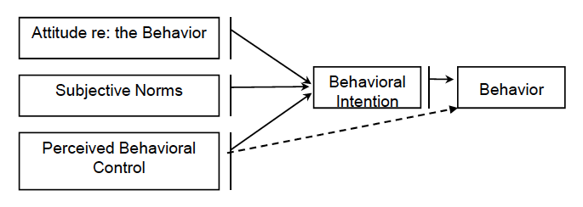
THEORY-DRIVEN RESEARCH
Theory of Planned Behavior: Such theories are used to guide Leave No Trace-focused research
(Adapted from Ajzen, 1991)
Attitudes, subjective norms, and perceived behavioral control all can influence behavioral intentions.
Intentions are the direct antecedent to actual behavior.
By understanding attitudes, norms, and perceived behavioral control, messages can be designed that leverage these constructs to ultimately influence the decisions people make when recreating.
Notes:
Leave No Trace-focused research is not building or testing theory. Rather it uses theory to orient the research, and ensure a rigorous methodology.
Attitudes – positive or negative evaluation of an object, a place, a person, a thing, etc. Can be formed very quickly but can be targeted and changed. Have significant influence on behavior.
Subjective norms – what others around you think – friends, family, peers, strangers, people in the community, etc. Norms can greatly influence behavior.
Perceived behavioral control – the perception of the difficulty of performing a behavior, e.g. digging a cathole or hanging a bear bag. Perceived behavioral control can alone predict behavior, i.e. if you can NOT do the behavior, it will likely not be done.

Slide 9
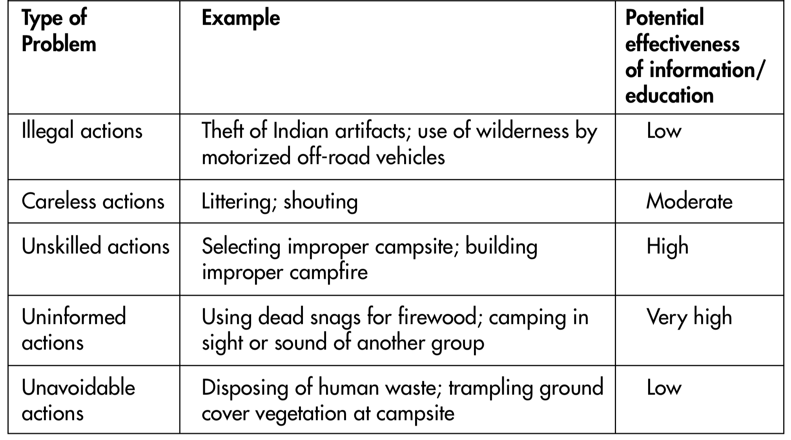
WHAT KINDS OF BEHAVIORS ARE WE TRYING TO INFLUENCE?
(Adapted from Manning, 2003)
Notes:
We focus on the carless, unskilled, and uninformed, and target them with strong and persuasive Leave No Trace messages to influence their recreation decisions.

Slide 10
HOW IS SUCCESS MEASURED?
The ultimate goal of Leave No Trace: to influence the decisions outdoor enthusiasts make regarding impacts
Success looks like:
  Decrease in biophysical and social impacts
  Decrease in maintenance needs
  Improved resource and social conditions
  Increased visitor satisfaction

Slide 11
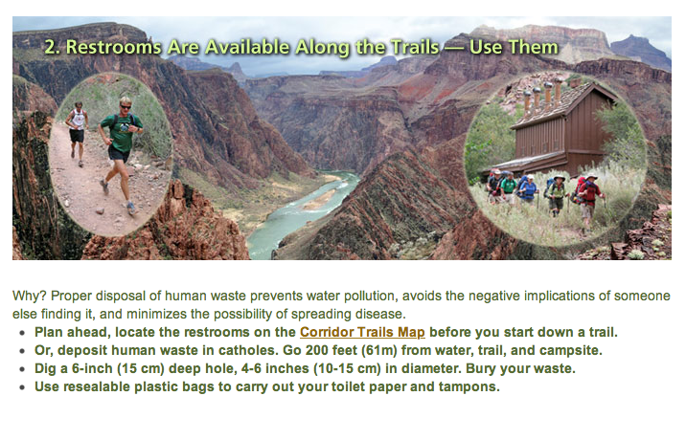
HOW IS RESEARCH INFORMING
LEAVE NO TRACE?
Notes:
Visitor-focused Leave No Trace research conducted in Rocky Mountain National Park, Wyoming State Parks, and on the Shawnee National Forest (IL) in partnership with Colorado State University, Southern Illinois University, and Penn State University directly informed the development of messages like this one from Grand Canyon National Park that focus on the “why” that underpins Leave No Trace recommendations.
This is part of Grand Canyon National Park’s “Rim to Rim” Leave No Trace education program.

Slide 12
HOW IS RESEARCH INFORMING
LEAVE NO TRACE?
Notes:
Bouldering-focused Leave No Trace research conducted in Rocky Mountain National Park in partnership with Penn State University directly informed the development of the bouldering ethics card.

Slide 13
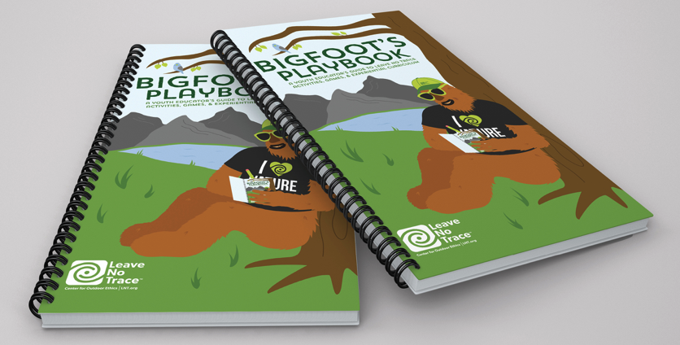
HOW IS RESEARCH INFORMING
LEAVE NO TRACE?
Notes:
Youth-focused Leave No Trace research conducted at an outdoor school in Pennsylvania in partnership with Penn State University directly informed the development of Bigfoots Playbook.

Slide 14



THE FUTURE OF
LEAVE NO TRACE RESEARCH
There are myriad benefits to continued Leave No Trace-focused HDNR research – for both people and the land.
As the Leave No Trace movement continues to evolve, research investigating visitor attitudes, perceptions, behavioral intentions, and behavior is critical for enhancing messaging.
Ensuring effective strategies for wide dissemination of research findings to land managers, educators, and the recreating public is vital for the future of our shared lands.

