Slide 1


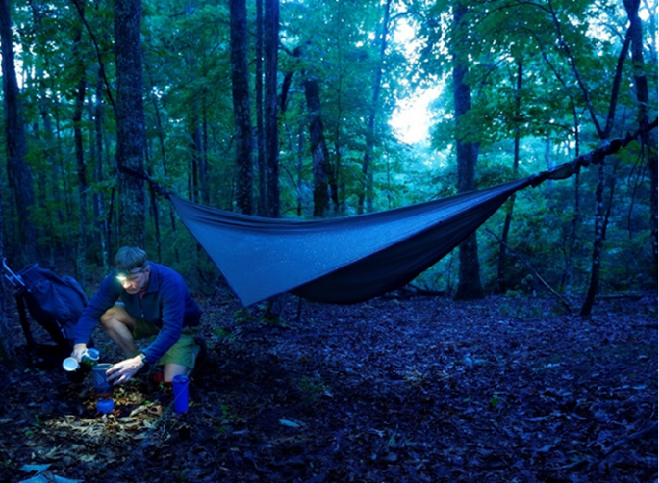


Recreation Ecology:
A Scientific Basis for
Leave No Trace Practices
Dr. Jeffrey L. Marion
Virginia Tech / U.S. Geological Survey
jmarion@vt.edu

Slide 2
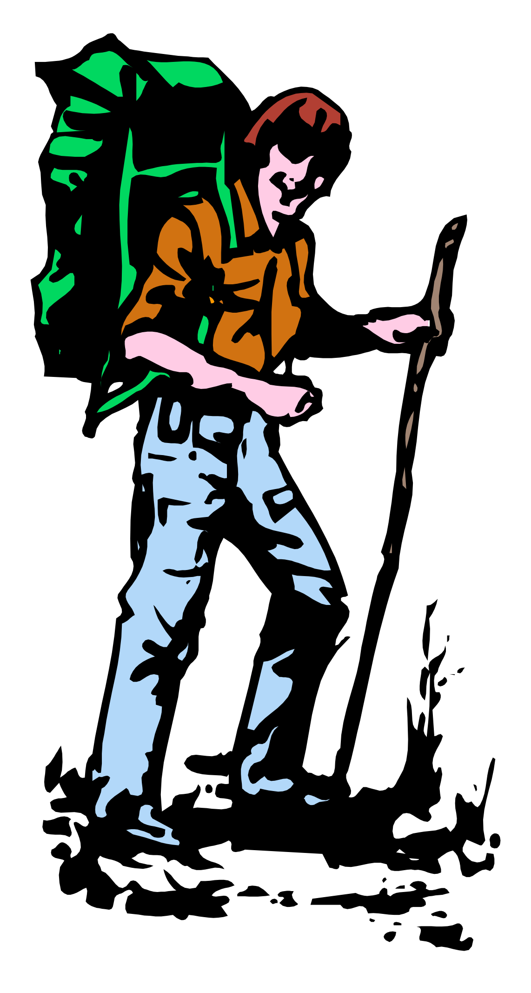
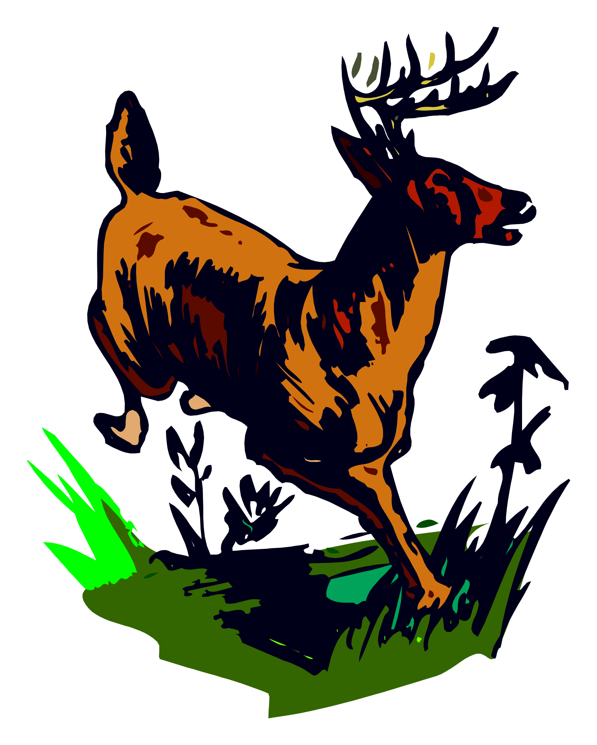
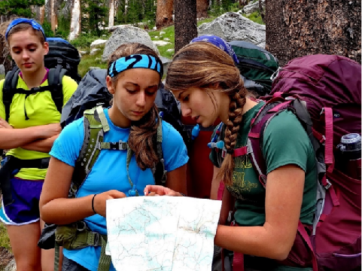
Presentation Objectives
Describe possible recreation impacts related to Scout outings.
Describe recreation ecology science and how it informs Leave No Trace practices that avoid or reduce recreation impacts.
Note:
All photos are from Jeff Marion’s Troop or Venture Crew outings, including Crew youth assisting in recreation ecology research.

Slide 3
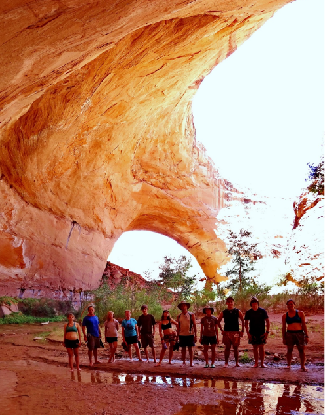
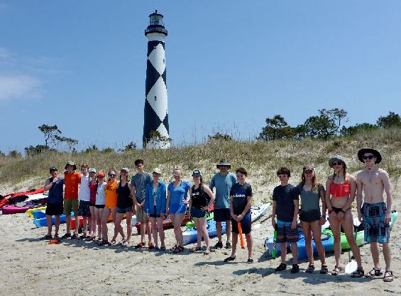
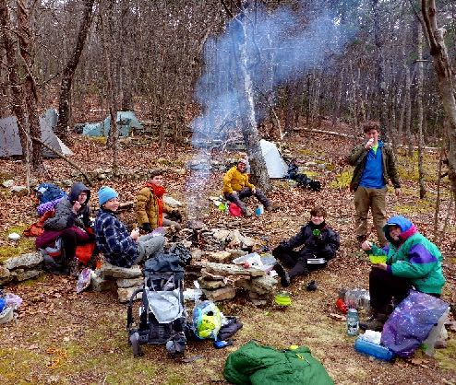
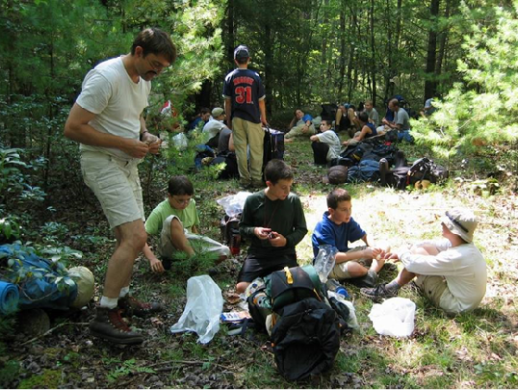
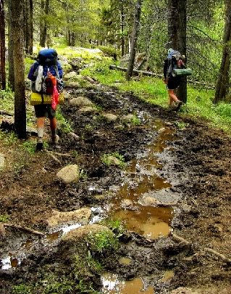
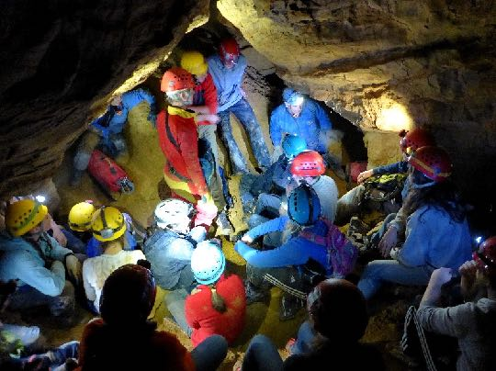
Scout Outings: Large groups,
Resource & Experiential Impacts

Slide 4
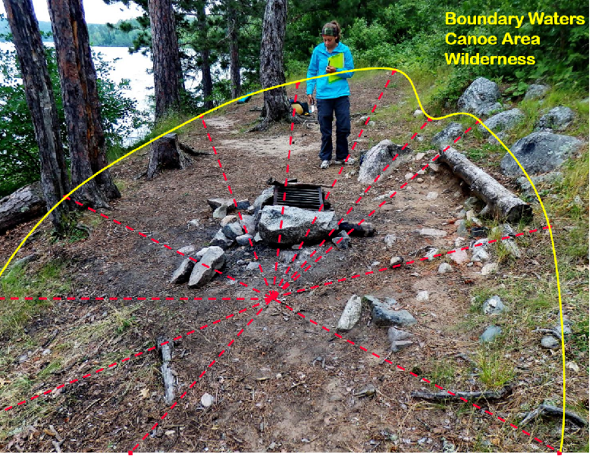
Recreation Ecology
Definition: Scientific field of study that evaluates visitor impacts to protected areas and their relationships to influential factors.
Applications:
Measure and monitor resource impacts,
Statistical modeling to ID factors that can be manipulated to avoid or reduce recreation impacts,
Inform the development of Leave No Trace practices.

Slide 5
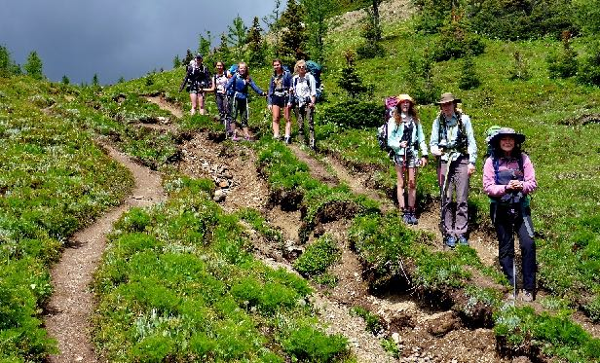
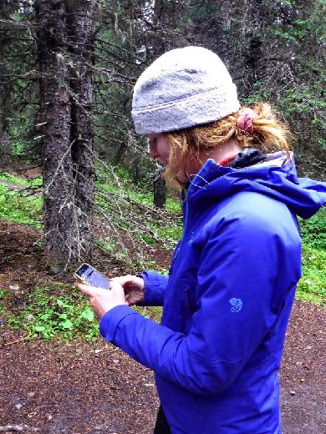
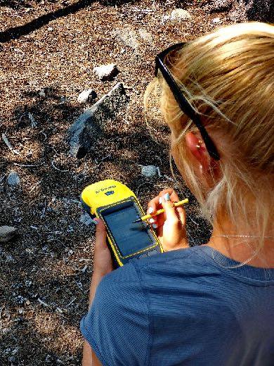
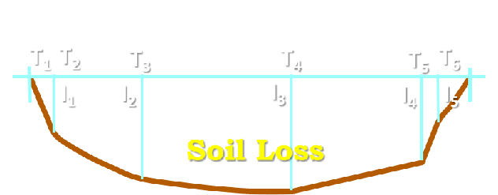
The Leave No Trace Message
Leave No Trace practices are science-based:
Recreation ecology research tells us about recreation impacts and the relative influence of use-related, environmental, and managerial factors. This information helps us to develop effective Leave No Trace practices.
Notes:
Recreation ecology is a field of study that investigates recreation-associated impacts to the resources of protected natural areas.
These studies commonly examine vegetation and soil impacts associated with trampling along trails, recreation sites, and campsites, and impacts to wildlife impacts associated with disturbance by recreationists or their food.
Relational analyses help to define the relative influence of various factors, such as the amount, type, or behavior of visitors vs. the resistance of different vegetation types or the influence of soil wetness.

Slide 6
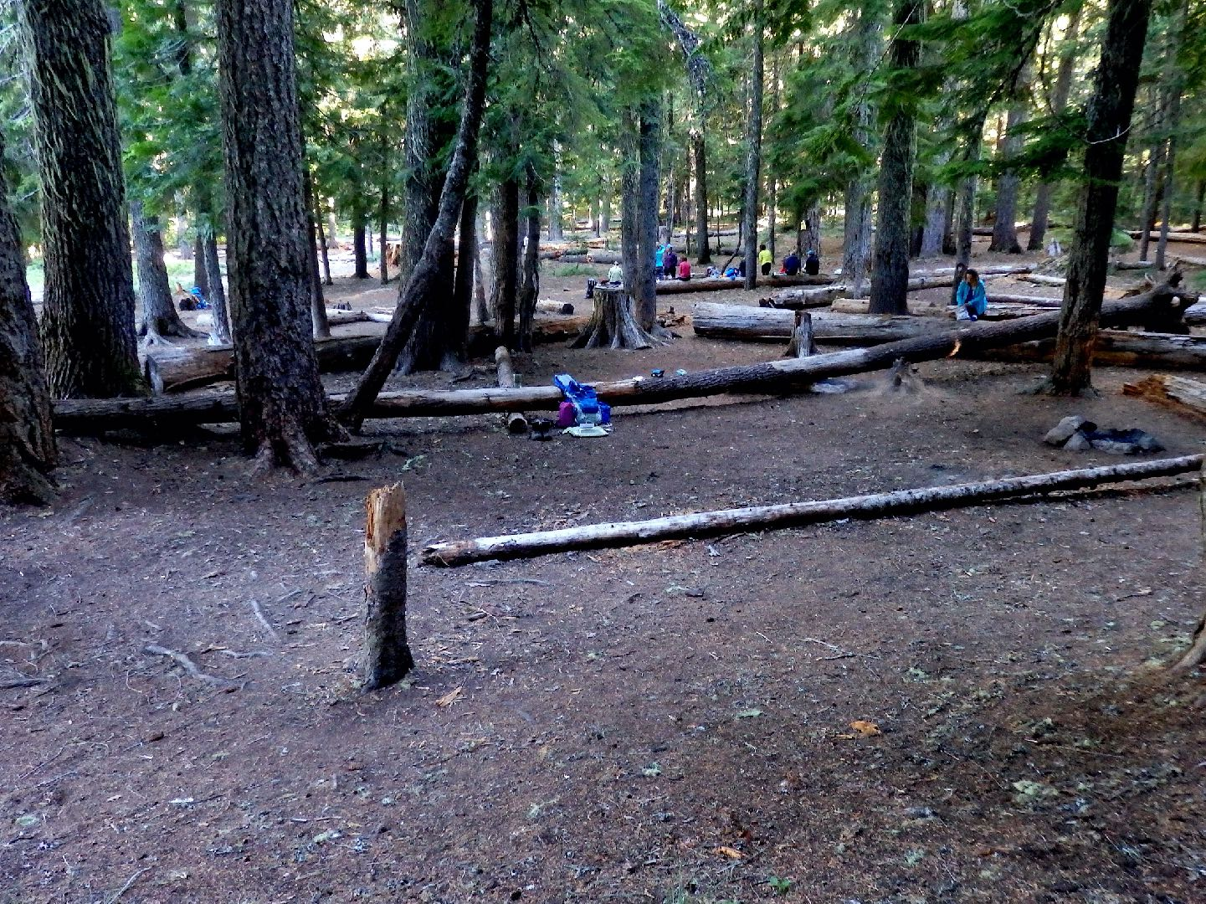
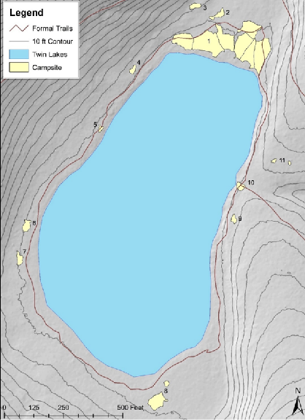
Impacts from Unregulated Camping
Pacific Crest Trail, Twin Lakes, Mt. Hood National Forest, Oregon
Problems:
Poor site selection – flat places!
Campsite proliferation
Campsite expansion
Resource – highly impacted
Social – crowding & conflicts

Slide 7
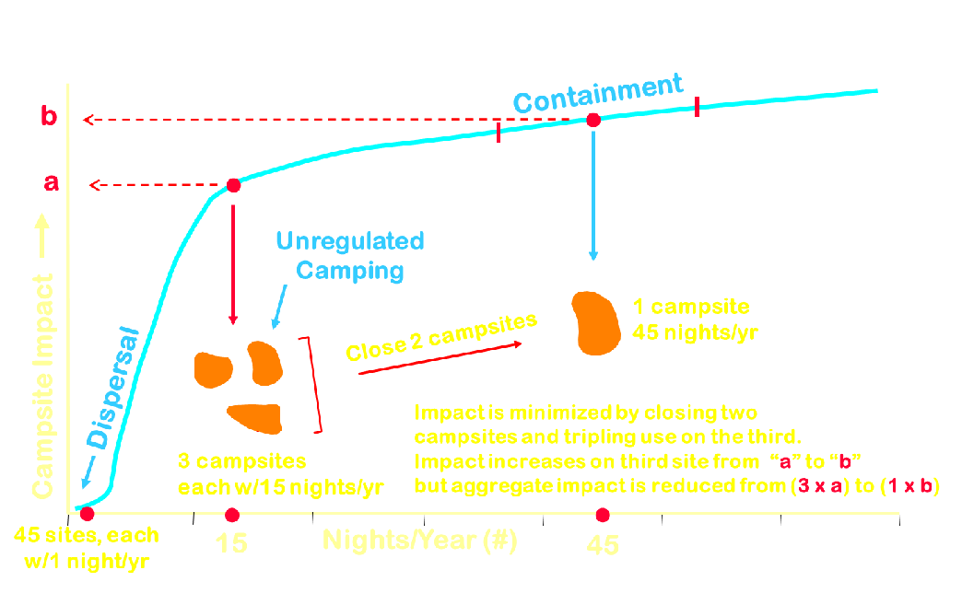
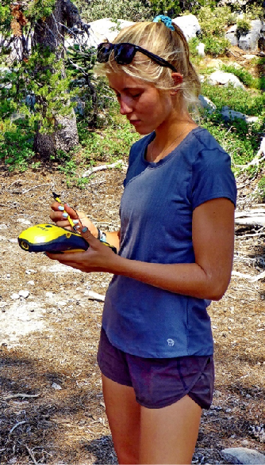
Camping Dispersal vs. Containment
Recreation Ecology research documents the effectiveness of dispersed pristine site camping and the containment of more intensive camping on the most sustainable sites.

Slide 8
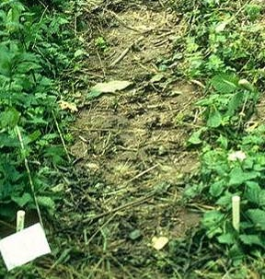
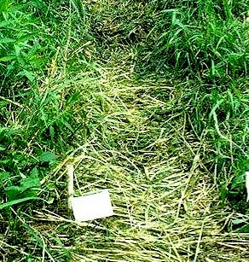
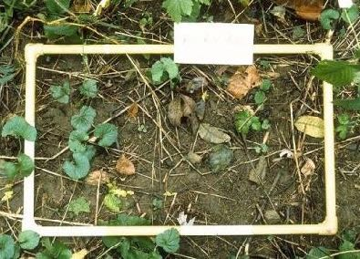
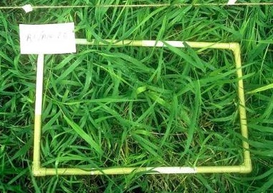
Vegetation Resistance & Resilience
1000 passes
1000 passes
Forest forbs have low resistance to trampling and low and resilience (ability to recover).
Grasses have high resistance and resilience in sunny locations (not shade).
Encourage camping in deep shade with few plants or sunny grassy locations.
1 mo. later
1 mo. later

Slide 9
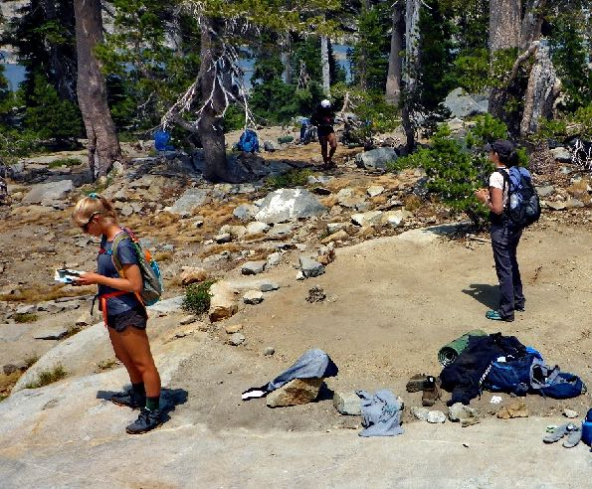
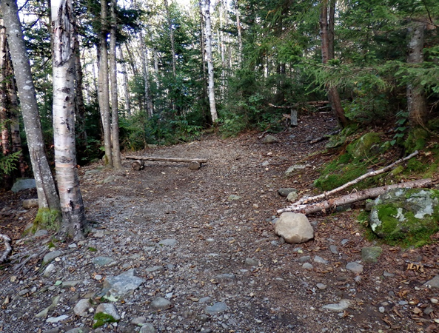
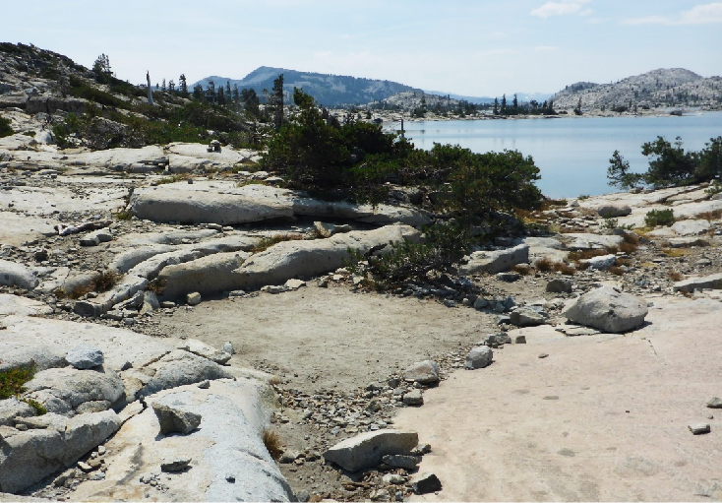
NEW Research Findings
Select campsites that resist
expansion due to:
Rugosity (rocky / uneven)
Sloping Terrain

Slide 10
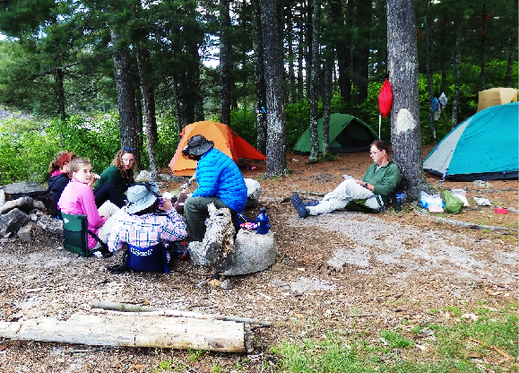
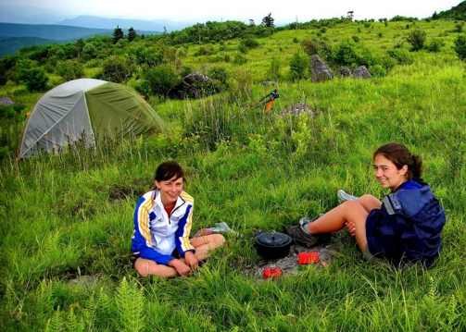
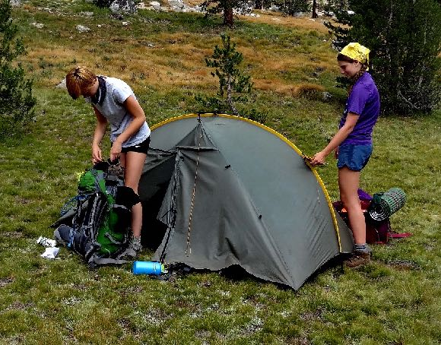
Camping Dispersal & Containment
Concentrate activities
Disperse activities

Slide 11
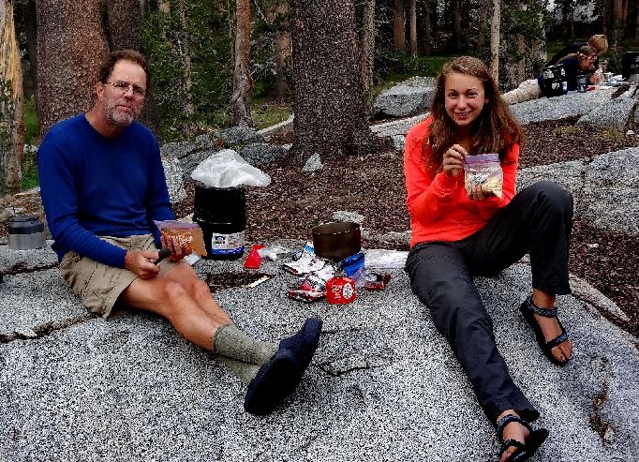
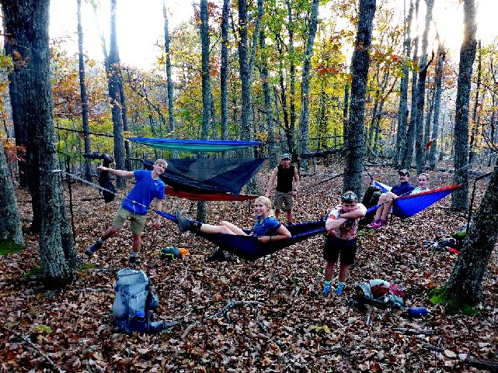
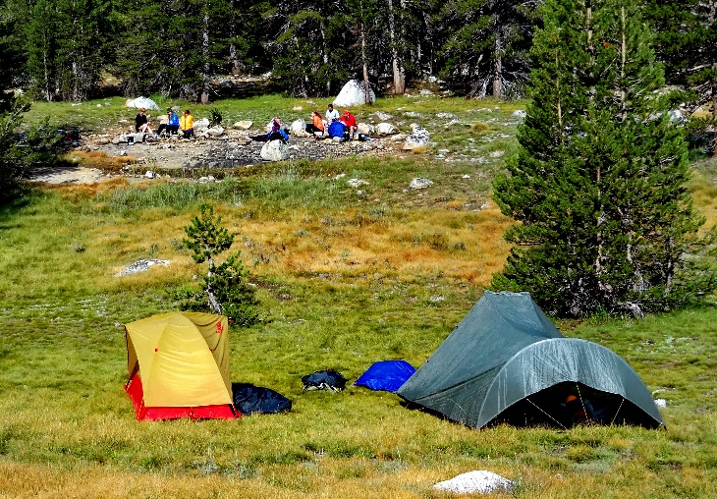
Dispersed Pristine Site Camping
Kitchen on naturally barren rock
Hammocks over barren leaf litter
Tents on resistant grass

Slide 12
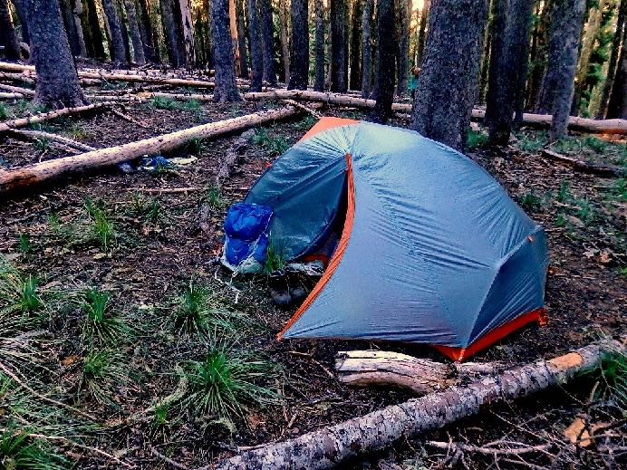
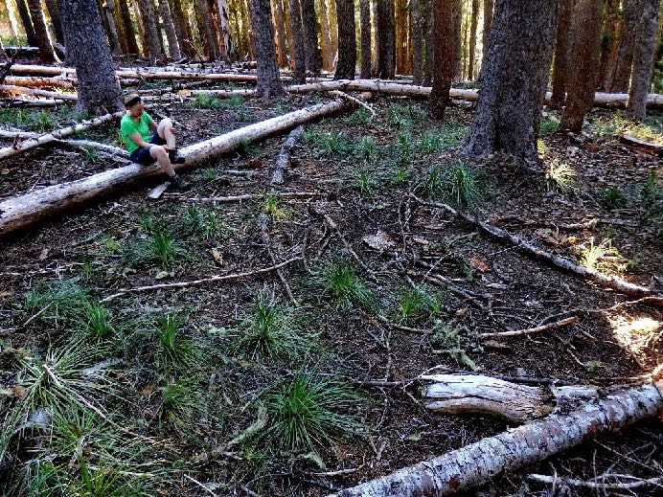
Dispersed Pristine Site Camping Guidance
Choose a durable spot (rock, deep shade with few plants, or sunny/grassy) out-of-sight from trails and campsites with NO prior evidence of human use.
Avoid all lasting disturbance while camping.
Before departing naturalize the spot so that others will not find or reuse it.

Slide 13
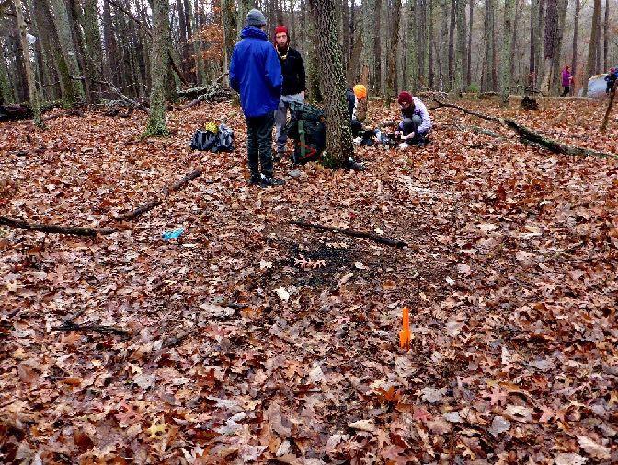
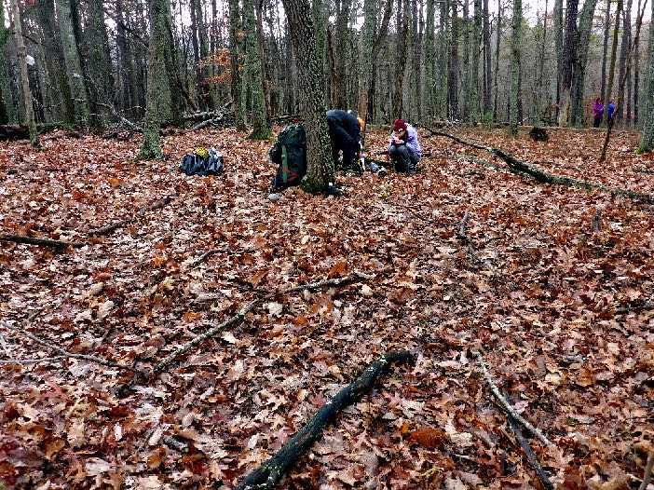
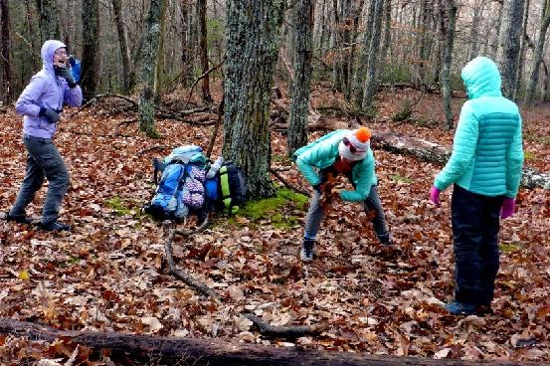
Dispersed Pristine Site Camping Guidance
Restore your camping spot before departing

Slide 14
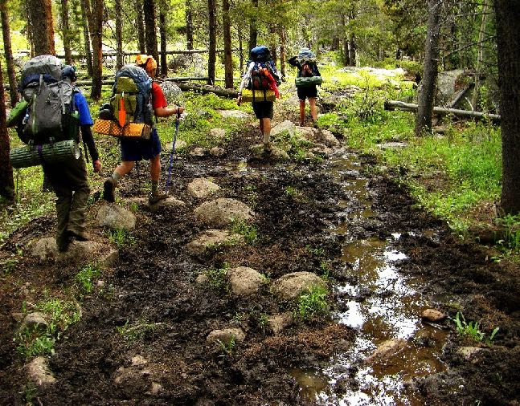
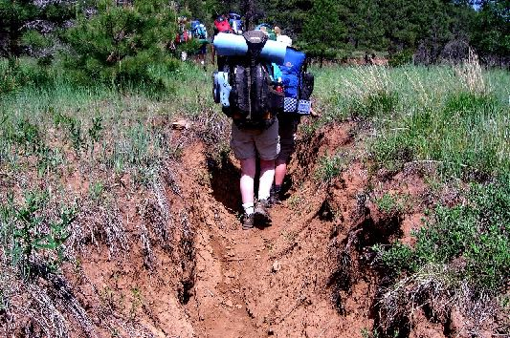
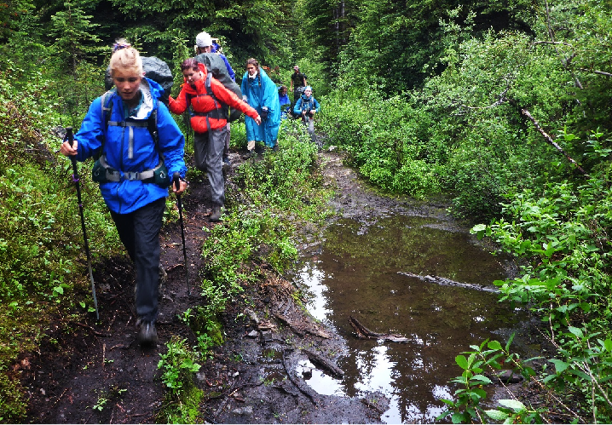
Impacts from Hiking on Trails
Problems:
Soil Loss
Trail Widening
Muddiness

Slide 15
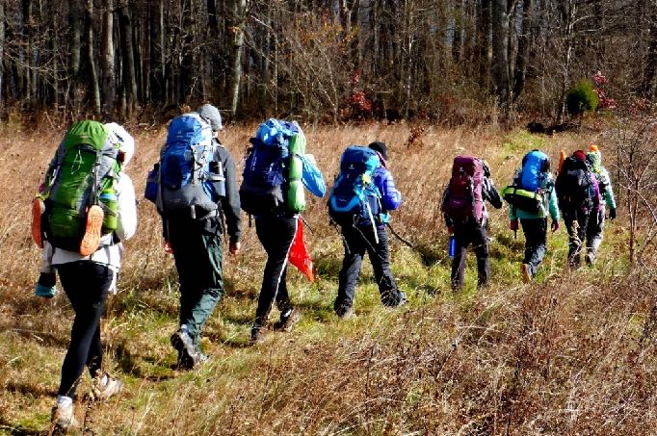
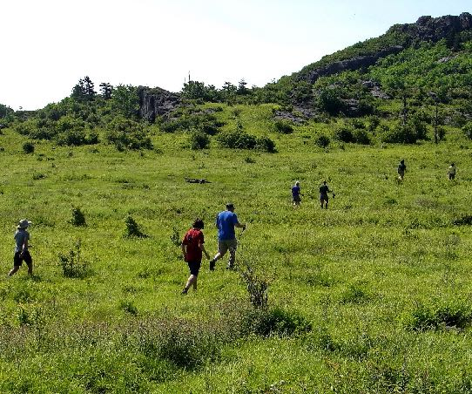
2. Travel and Camp on
Durable Surfaces
Low Impact Practices:
Stay on formal trails when possible and do not cut switchbacks. Walk single file in the center of the tread. Disperse off-trail traffic to prevent creating new trails.

Slide 16
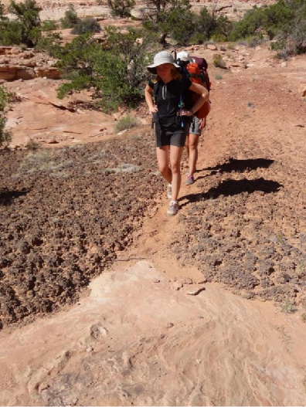
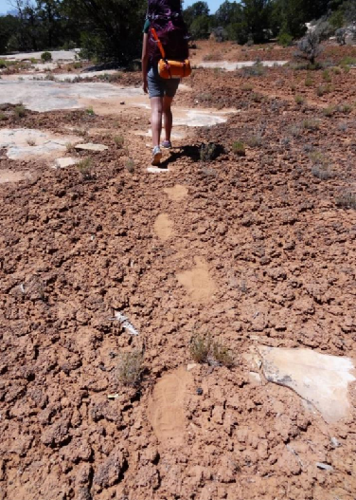
2. Travel and Camp on
Durable Surfaces
Low Impact Practices for cryptogamic soils:
Concentrate traffic to a trail (high use areas) or to footsteps (low use areas).

Slide 17
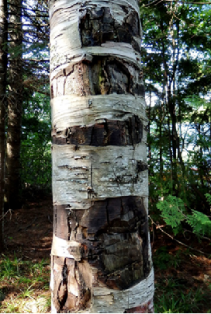
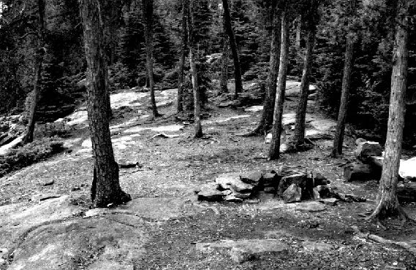
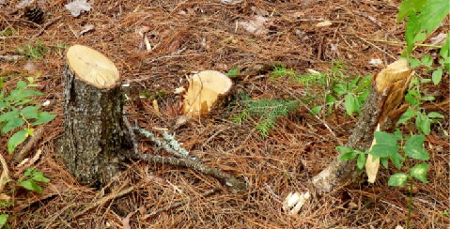
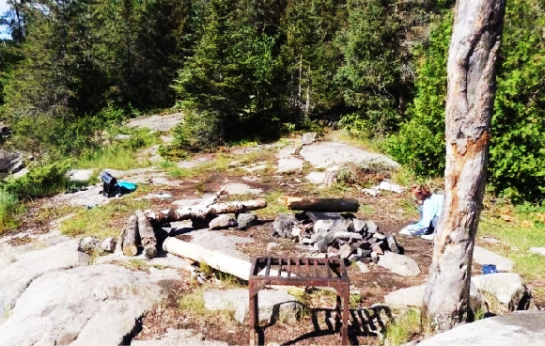
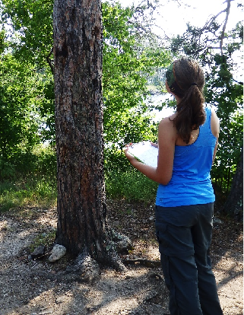
Impacts from Woods Tools
Boundary Waters Canoe Area Wilderness, Superior National Forest, Minnesota
1982
2014
Problems:
Damage to campsite trees
Felling of campsite trees for firewood

Slide 18
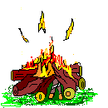

5. Minimize Campfire Impacts
Low Impact Practices:
Use a stove for cooking and a candle lantern for light.
Only build a campfire when permissible on existing fire sites, keep it small and burn for a short time
Use dead and downed wood that you can break by hand. Leave woods tools at home.
A Leave No Trace
“virtual” campfire!

Slide 19


Hammock Strap Tree Impact Study
Study done by Venture Crew youth Shayla Utzinger for an AP High School research class.
  Tested paracord (.16”), 1”, and 2” Eno straps.
  Tested a tight hang (20º) and a loose hang (47º).
  For an avg U.S. male of 198 lbs the force exerted on a tree from the loose hang is 135 lbs and from a tight hang is 298 lbs (i.e., more than double!).
  Depth of indentation into the foam was measured with a caliper in millimeters for each foam block.

Slide 20


Hammock Strap Tree Impact Study
Taut Paracord
Foam Axis
Foam Indentation (mm)
Loose Paracord
Taut 1” Strap
Taut 2” Strap
Loose 1” Strap
Loose 2” Strap

Slide 21

Hammock Strap Tree Impact Study
Results and Leave No Trace Implications
  Paracord or rope should not be used for hammocks.
  One-inch straps are acceptable, but 2-inch straps are best at distributing the weight.
  A tight hang substantially increases (291%) the force that a hammock places on trees compared to a loose hang.
  Choose trees ≥6” diameter, preferably w/hard bark and no lichen.
  Set up hammock and cook on durable non-vegetated surfaces. Save the best tent spots for others.

Slide 22

Happy trails and remember to . . .
Leave No Trace !

