Slide 1
Bringing
to Scouting
Notes:
Time allocated: 15 minutes
Materials needed:
Outdoor Ethics Guide Handbook publication #510-047
Outdoor Ethics Awareness and Action Awards publication #430-063
BSA Leave No Trace Basics Course Guide
Noactivity

Slide 2
Bringing to Scouting
Expectation for Leave No Trace Instructors:
Train others in Leave No Trace
Promote Leave No Trace
Notes:
At the start of this training, we asked each of you what your expectations were for this training.
It’s our expectation that each of you will share the Leave No Trace message with others.

Slide 3
Bringing to Scouting
Share the Leave No Trace message:
Planned
Training sessions
Displays
Unplanned
Teachable moments
Notes:
Think about all the opportunities each of us has to share the Leave No Trace message.
We will look some of the formal ways to share the message in the following slides.
But I don’t want to overlook the opportunities afforded by teachable moments.

Slide 4
Bringing to Scouting
BSA Trainings with a Leave No Trace session:
BALOO (Basic Adult Leadership Outdoor Orientation)
IOLS (Introduction to Outdoor Leadership Skills)
Wood Badge
Powder Horn
Notes:
Several BSA trainings include a session devoted to Outdoor Ethics/ Leave No Trace.
These sessions are allocated 30 minutes.
Each of these trainings have a syllabus that forms the basis of your presentation.
BSA Outdoor Ethics resources include flip books for BALOO and IOLS

Slide 5
Bringing to Scouting
BSA Trainings with more in depth Leave No Trace:
National Camping School: Ecology and Outdoor Skills sections
Notes:
I need the current syllabus for National Camping School to determine the content of these sessions.

Slide 6
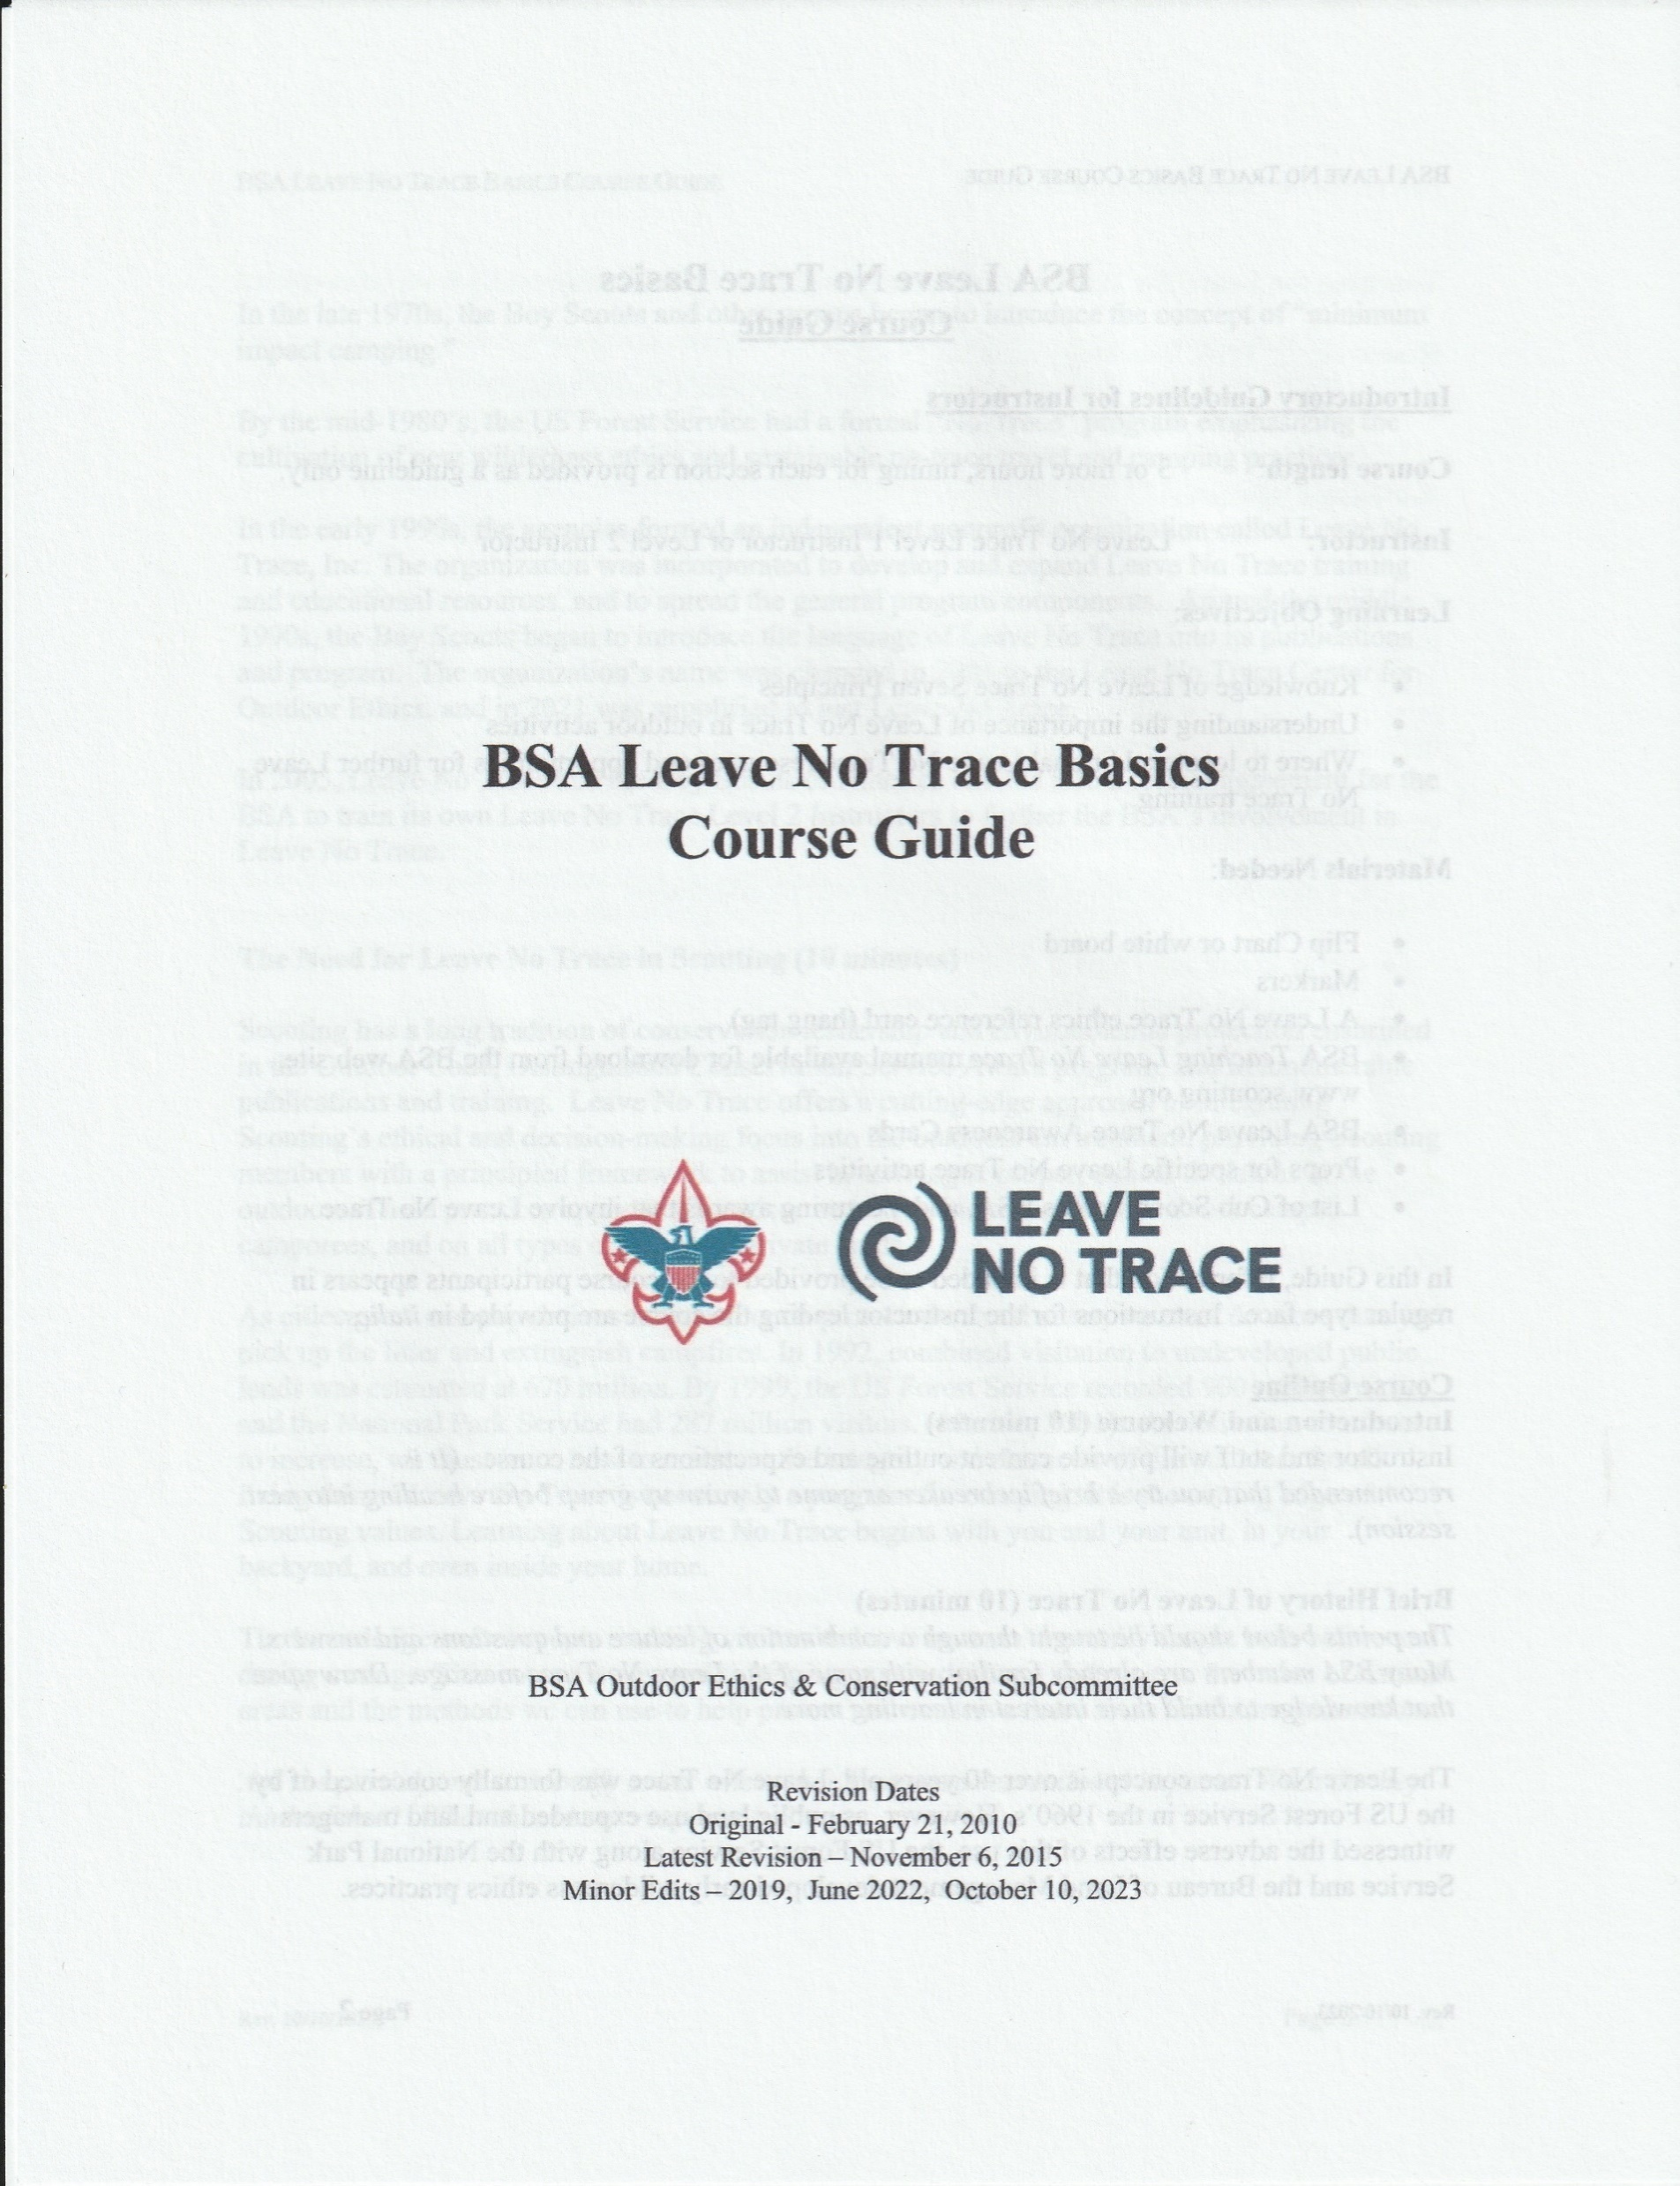
Bringing to Scouting
BSA Leave No Trace Basics
3 hours or longer
Could be a stand-alone training
Could be part of:
University of Scouting
Merit Badge College
Outdoor Ethics themed camporee
Conservation themed camporee
Summer camp program
Notes:
BSA standard workshop is BSA Leave No Trace Basics
This training was formerly titled “BSA Leave No Trace 101 course.” Name change to eliminate confusion with Leave No Trace’s new online 101 Course.
Many options for where this course might be offered.
Does not need to be done in one session, but should be completed within 30 days.
Course Guide (6 pages) includes resources, course outline with minimum timing for each session, as well as other information

Slide 7
Bringing to Scouting
Promote Leave No Trace within Scouting:
Leave No Trace Workshops (30 minutes to 8 hours):
Roundtables
Camporees
University of Scouting
Notes:
Leave No Trace Workshops are 30 minutes to 1 day.
Opportunities abound at Roundtables, Camporees, University of Scouting.
Some Councils have a separate track for Outdoor Ethics at their University of Scouting.
Follow Workshop Guidelines at https://lnt.org/get-involved/training-courses/recreational/

Slide 8
Bringing to Scouting
Promote Leave No Trace within Scouting:
Displays:
Roundtables
Camporees
University of Scouting
Other gatherings
Notes:
A staffed display table can be set up at almost any gathering.
Good activities to include (time permitting:
Question Ball
Trash timeline
Surface hopscotch

Slide 9
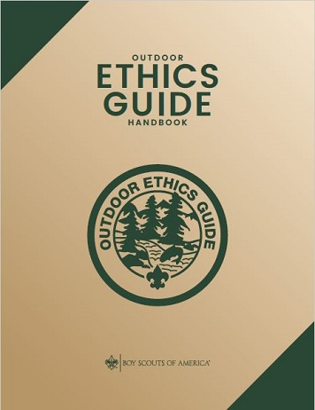
Bringing to Scouting
Outdoor Ethics Guide & Outdoor Ethics Guide Advisor
Youth Leadership position of responsibility
Notes:
At the troop level, there is the Outdoor Ethics Guide position
This is a youth leadership position of responsibility.
BSA publication “Outdoor Ethics Guide Handbook” is an excellent reference (BSA#510-047)

Slide 10
Bringing to Scouting
Promote Leave No Trace within Scouting:
The Outdoor Ethics Awareness and Action Awards Program
Notes:
This program is an excellent way to introduce Leave No Trace to Scouts
The Awareness Award requirements include watching Leave No Trace videos and their on-line course.
Requirements for the Action Award adds a service activity.

Slide 11
Bringing to Scouting
Outdoor Ethics Advocate
Council level position
Recommendation: One in every Council
Usually a member of one of the program committees:
Typically Conservation Committee or Training Committee
Notes:
At the Council level, there is the Outdoor Ethics Advocate position.
Go to the Outdoor Programs, Outdoor Ethics section of Scouting.org to find the current Outdoor Ethics Advocate for your council.
And, if there is a vacancy, consider stepping up.

Slide 12
Bringing to Scouting
How will you put your new Leave No Trace knowledge into action in your council, district, and unit?
Notes:
Group discussion: Have as many participants as time allows give their best estimate as to how they will personally put their new Leave No Trace knowledge to work in the council, district, and unit(s).

Slide 13
Revision History
Original (pl) - 11/25/2023
Edits (mh) – 1/6/2024 - Leave No Trace Workshops, (no OE Guide Training), minor edits

