Slide 1
Leave No Trace Meals
BSA National Outdoor Programs & Properties
National Outdoor Ethics & Conservation Subcommittee
Outdoor Ethics & Conservation Roundtable
November 8, 2023
Mark Hammer
Notes:
Prepared. For Life. – National Council’s Motto that captures the goal of Scouting.
Scouting’s Outdoor Program
– Key Method for Delivering on the Promise of Fun and Adventure
- Through Outdoor Program, outdoors serves as our classroom for teaching / learning, for Experiences that will develop many those “Prepared. For Life” attitudes and skills.

Slide 2
Premise
Food considerations are major part of Scouting’s outdoor program.
Meal preparation and cleanup, food storage, and food waste disposal have potential negative impacts to the environment and other visitors.
Different settings and preparation methods require different practices, skills and equipment.
Every Scouting outing meal can be a “Leave No Trace meal” with proper planning, preparation, equipment, skills and practices.
Example practices, tips, and meal ideas.
Notes:
With that background, this Roundtable’s Focus is on the following base ideas:
Meals are an important aspect of our outdoor program
Everybody needs to and likes to eat, Food Motivates us. Make our outdoor meals part of the Fun & Adventure
Outdoor meals are wonderful learning experiences.
However, our “Food Cycle” has potential impacts to those places where we camp, and to the larger environment.
Following Leave No Trace shouldn’t limit what we can eat, but will inform how and where we do it, so we can enjoy our meals responsibly.
For this Roundtable, we will first explore these ideas in more detail, and then give some suggestions about particular tips and meals which can be used in your trainings or outings.

Slide 3
Premise – November 2021 Roundtable
Meal preparation and cleanup is too good a training opportunity to waste on simply feeding staff and participants!
Food considerations are major part of Scouting’s outdoor program.
We must demonstrate that we can enjoy good meals and accomplish program goals -- while using Leave No Trace to minimize our impacts.
Setting the example during the course with different techniques teaches the need for and demonstrate the practicality of doing effective Leave No Trace meals.
  From BSA Leave No Trace Trainer Course Manual - Food (p 6)
Notes:
At a previous Roundtable, Maria Brown and I discussed how to use meals for experiential learning at Trainings.
(Points) Please see that archived presentation for more on that topic.
This discussion is more on general Leave No Trace Meals, with lots of ideas an tips.

Slide 4
What is a “Leave No Trace” Meal?
Is it “What” is on the Menu?
“How” and “Where” are more important?
Notes:
Is it the menu – “What” we eat? Eating pizza is Leave No Trace, but eating spaghetti is not?
Maybe questions like “How?” we do it, and “Where?” it is appropriate are more important than “What?”
The How and Where will help us decide What

Slide 5
What is a “Leave No Trace” Meal?
Planned considering Leave No Trace Seven Principles
Pre-Outing Preparation
Awareness/Knowledge, Skills, Equipment, Commitment > Good Judgement while on the outing
Experiential Learning – Do, Reflect, Generalize, Apply Learning to Next Time
Notes:
Becomes Second nature to those Experienced in Leave No Trace
Planning Tools - Scouts (and other beginners) need guidance and “Tools” to learn to Plan. A Key example is the Outing Planning Workheet in OE Guide handbook Appendix. Several others (Josh Lamothe, Ted Shigley) on our “Other Resources” webpage.
To use Dave Hatch’s aspects
Success – eliminated avoidable impacts and minimized unavoidable impacts.

Slide 6
Our “Food Cycle”
Planning:
  Location/restrictions/schedule, participants, cooking method / menu, ingredients/amounts
Preparation:
  Shopping, advanced preparation, packaging
Transport, storage
  (cont…)
Notes:
Mark

Slide 7
Our “Food Cycle” (cont)
Meal Preparation:
  Food prep, cooking, serving
Eating!
Cleanup:
  Clean dishes, utensils, pots, stove, table.
  Disposal of wash/rinse water
  Leftovers/trash/garbage storage, transport
  and disposal.
Notes:
Mark
Cleanup - Dry and put away
Repeat next meal

Slide 8
Food Cycle - Beyond Just the Food
  Food Safety
  Equipment & Supplies for each step
  Recipe/Instructions for cooking
  Site/Kitchen location, organization, setup
  Water. Fuel, stove, wood & fire prep
  Fire out, dispose of ashes
  Bear box / hang / canister
  Leftovers / reusables / recyclables / compostables
Notes:
Mark

Slide 9
Planning - What do we need to consider?
All aspects of the “Food Cycle”
Program Level, Group Size,
Location/Facilities/Weather
Special Cooking Methods
Participant Dietary Needs, …
Notes:
Food Cycle – elaborate that next
Special Cooking Methods: Fire: Dutch Oven, Foil Meal, S’Mores
These are not completely independent considerations! Choices in some areas will limit / factor into the choices for others.
For example, Dutch Oven Cooking is not for backpacking; or Cubs are Frontcountry with facilities
All these aspects considered with respect to the Principles as a framework for

Slide 10
Other Meal Considerations
Short-Term Camp Guidelines
  STC Administrator Approval of Menus for District/Council Events
  Nutrition, Special Dietary Needs (Allergies, Gluten, Diabetic, Religious, Lifestyle)
  Food Safety Protocols
  (Prep and Serving),
  Storage
  Waste Disposal
Notes:
More formal approval required for Dist/Council events
STC Approval not required for Unit Activities – Use Guide to Safe Scouting, but still good to consider

Slide 11

Which Principles Apply?
Plan Ahead and Prepare – Yes!
Travel and Camp on Durable Surfaces – Yes
Dispose of Waste Properly – Yes!
Leave What You Find – some
Minimize Campfire Impacts – Yes!
Respect Wildlife – Yes!
Be Considerate of Others - Yes
Notes:
Emphasis on Plan ahead and Prepare:
Prep – amounts, pre-cook (esp raw meat), repackage in re-usable containers, pre-cut, pre-mix,
Coolers for FC, Drying foods for BP
T& C = Select “Kitchen” site – most traffic, most durable
DWP – Huge – more in a minute
LWYF – firewood, Be prepared for site – don’t build structures, dig holes, …
MCI – Stove for cooking in backcountry. Fires in suitable LNT location, clean up!
RW – Proper Food/waste storage. Site choices. Food choices in eg bear country.
BCOV – Your group – consider food preferences and needs. Sanitation / Food Safety!
Leave Clean site for future users.

Slide 12
Global Sustainability
Notes:
Bigger Picture - Beyond basic Leave No Trace – Although they are certainly moving in this direction
Two issue relevant to today’s discussion
- Climate Change is biggest Existential threat facing us and especially future generations.
- Plastics –
There are things we can do!

Slide 13
Drawdown.org
The World’s Leading Resource for Climate Solutions
Project Drawdown’s mission is to help the world stop climate change—as quickly, safely, and equitably as possible.
Identified and are Advancing 90+ effective, science-based climate solutions and strategies.
Notes:
Global Climate change
Many hundreds (thousands) of organizations working on aspects.
Big Picture - Broad range of things that must be done –
Project Drawdown (founded by Paul Hawken) is looking at the big picture of climate change
Major Areas
Electricity
Food, Agriculture, Land Use
Industry / Transport / Buildings
Sinks – Land/Ocean/Engineered
Health & Education
To get us to Net 0 CO2, and longer-term – reduction. Much depends on governments (politics), business & industry, agriculture.
But there are many things we can do!

Slide 14
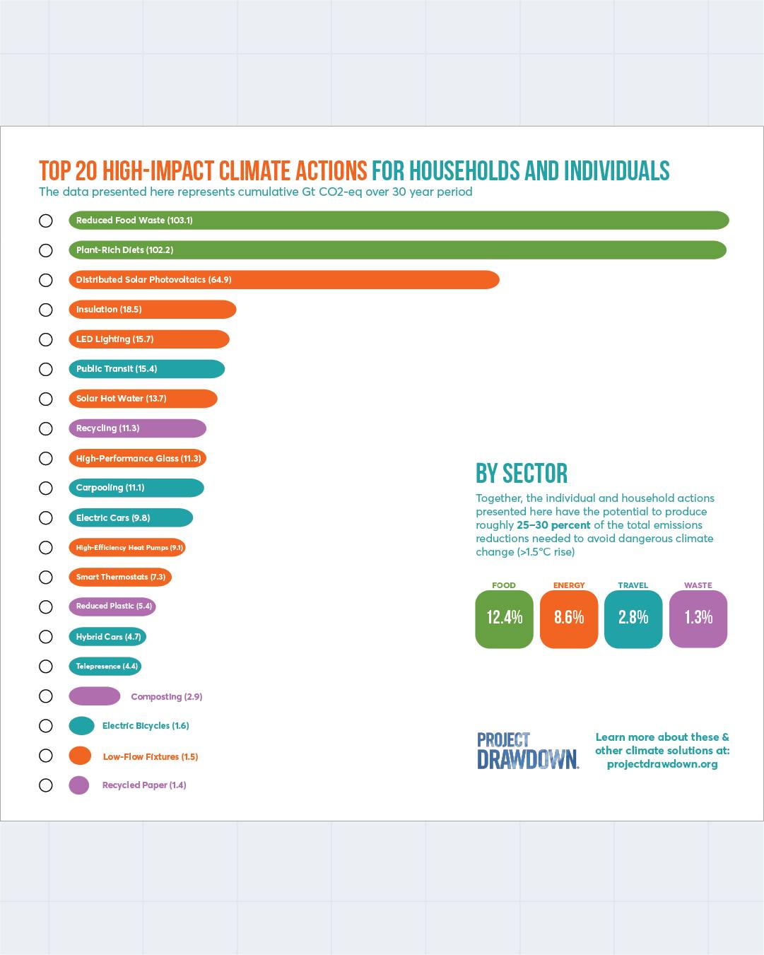
Drawdown Actions for Individuals
Notes:
Household actions (in high-income countries) can contribute 25-30% of the needed reductions!
(Oct 2021)
1/3 of food produced globally is wasted. Production / Transportation / Preparation / Disposal costs
Cut food waste by ½ - 8%-10% of the TOTAL reduction needed. Plant-rich diets – another 8-10%
https://drawdown.org/news/insights/the-powerful-role-of-household-actions-in-solving-climate-change

Slide 15
Food Waste on Outings
Preparing Too Much
  Pay attention to # servings, sizes.
  Participants ? – Age, picky or big eaters
  Individual Choices (ingredients, amount)
  FC: Plan for Leftovers - Containers/Cooler
  BC: Quantities! 1.2# - 1.5# dried / person / day, Flexibility
Messy Methods (Frying, Boiling Pasta)

Slide 16
Food Waste on Outings
Preparation Problems (over/undercooked, seasoning, spills…)
  Recipe – try at home
  Cooking instruction, practice, experience
  Simpler “cooking” techniques
Individual Preferences (Picky?)
  Planning – Inclusive
  Personal Choice Options

Slide 17
Global Sustainability
Single Use Plastics
  Packaging is biggest (over half) plastics industry segment
  5 Trillion plastic bags annually (730,000 tons US)
  US - 50 billion water bottles annually
  Most of this will outlive us (… our great-grandchildren)
Simple Things We Can Do
  Frontcountry: Use Reusable containers
  Backcountry: Reuse resealable bags
  Reduce/Reuse/Recycle,…

Slide 18
Dispose of Waste Properly
- Better Alternatives
Avoid/Minimize Single-Use Plastics
Reusable Containers
Avoid Creating the Waste Food
Save Leftovers, Store Properly, and Eat Later
Use Mess Kits, Water Bottles, Not Disposables
Recycle
Compost Scraps
Notes:
Summary –
Dispose implies throw it away (properly) - Go Well Beyond Dispose
Awareness/skills/commitment
Push camps to get back to dishwashing
Make it a game – how little trash can your patrol create on campout?

Slide 19
Meal Examples & Tips
Detailed Examples – Progression
  Meal/Cleanup Steps, What Did We Learn
Another Frontcountry Meal Example
Backcountry Options & Ideas
Tips interspersed

Slide 20
Saturday Lunch
Pasta (couscous) and sauce (backcountry)
Tossed Salad, Cheesy Garlic Bread (frontcountry)
Cooking Tasks Wash Hands!
  Rehydrate Sauce “leather” and Couscous in Bags.
  Add pepperoni to 1 bag of sauce.
  Slice bread, spread topping, Fry until hot/browned
3-Pan Cleanup – Everyone Helps!
  Scrape Dishes and Pans clean; Wash, Sanitize & Rinse
  Put food away, cleanup tables, stoves, area
  Demonstrate straining and disposal
Notes:
Mark
Then we do it
Serve bread hot

Slide 21
What did we learn from Lunch?
Advanced Preparation
– eliminate prep mess, quick & easy prep
Rehydrate Group Meal in Bags
Pasta without starchy waste cooking water
Sauce in Bag instead of Pan
  No sticky pan, Not burned to bottom
  Not splattered all over stove
  Easy to save leftovers or dispose empty bag
  Vegetarian Option
Durable Surface for Kitchen
Notes:
Mark
Easy to accommodate vegetarians, non-
Strain with strainer into facility

Slide 22
What did we learn from Lunch Cleanup?
Tablecloth – Sanitation, mess prevention, easy cleanup
3-Pan Method, Proper disposal of wastewater
“No Chunks” – clean before washing
  Use bread to wipe, or Pot scraper
Leftovers/Recycle/Compost/Trash
Generalization – Use this in the Future?
Notes:
Mark
Training Progression – Start with messier meal, use more advanced techniques to make less mess for each successive meal. Dinner will be similar, but just heating quesadilla – no fry spatter; not goopy.
Easy to accommodate vegetarians
Strain with strainer into facility

Slide 23
Saturday Evening Meal
Quesadillas (frontcountry or backcountry)
  Wash Hands!
  “Assemble” and cook your own (Avoid Making Messes! Prep/Eating)
3-Pan, “No Chunks” cleanup for pans (frontcountry)
  Heat water for cleanup
  Everyone help with cleanup
  Strain wash water w/ screening, and Rainbow
Notes:
Mark – skip

Slide 24
Evening Meal
What did we learn from meal?
  Advanced Preparation
  Personal Choices – Amount & Toppings
  Example gluten-free alternative – corn tortillas
  One-Pan cooking
  Don’t walk around dripping food – use plate/bowl, sit
  Reusable containers
  Scrim cloth?
Notes:
Don’t walk around dripping food – sit or use plate/bowl

Slide 25
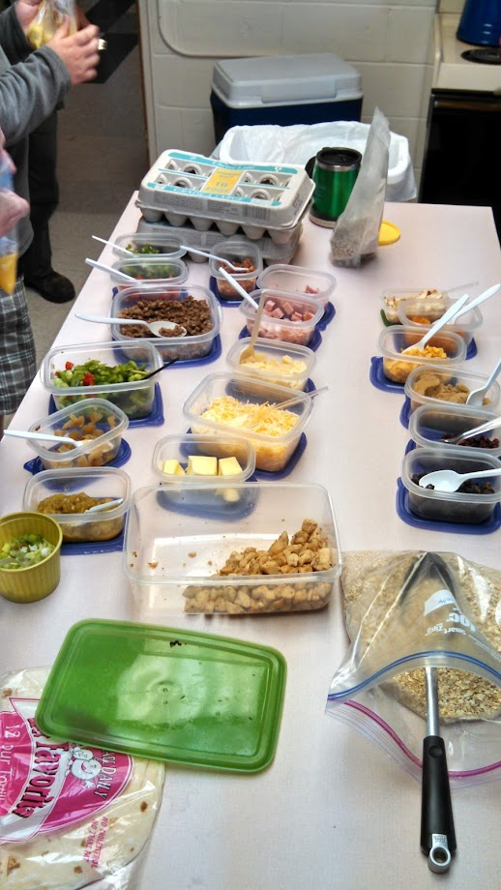
Breakfast
Hot Cereal, Freezer Bag Omelets
(front or backcountry)
  Wash Hands!
  Omelets - write name on bag, crack eggs into bag (help from buddy), add extras, note the time “in”, cook for ~13 minutes (or done).
  Oatmeal: Cereal mix, fruit/nuts/etc and hot water – mix in your bowl, eat

Slide 26
Breakfast Cleanup
Minimum Water, One Bowl Cleanup (backcountry)
  Tablespoon of hot water, slosh around, “Sump” your bowl.
  Optional - Tablespoon of hot water, drop of soap, scrub.
  “Rainbow” the water away from camp
  Tablespoon of water, rinse. “Rainbow” the water
  Sanitize in boiling water before next meal
Freezer Bag (either)
  Eat from bag or serve in tortilla
  Put empty bag in pocket (or w/ smellables) & use for trash bag
Notes:
Mark
Don’t put smellable in pocket overnight in bear country.

Slide 27
Breakfast
What did we learn from breakfast?
  Easy Hot Breakfast
  Advanced Preparation – Cereal Mix, Chopping Ingredients
  Personal Choices – Quantity, Selections
  Personal Cook in Bag
  Personal Cook in Bowl
  Using Leftovers
  Reusable containers vs Bags
  One bowl cleanup
Notes:
Mark

Slide 28
Sunday Lunch
Sandwiches, Fruit, Dessert (frontcountry)
  No-Cook
  Quick, Minimum Cleanup
  Advanced Preparation
  Personal Choices
  Using Leftovers
  Reusable Containers
Notes:
Mark
Leftovers – offer eg tortillas, cheese, peppers, … from previous meals for additional variety

Slide 29
Tip - Sanitation is Important!
Notes:
Hints & Tips
Sanitation is important in keeping you and your group healthy! (Neither Philmont nor Northern Tier have handwashing in trek protocols.)
Recent article in Outside magazine about a Norovirus outbreak on the Pacific Crest Trail last year. Dozens got sick. Hand sanitizer works well on bacteria, but doesn’t work on some viruses.
Wash hands before handling food! Soap & Water, Sanitizer
I have done this for many years and I Use on course treks. Small basin – a little hot water, few drops of soap. Dip hands quickly, step away and scrub, shake off, dip again, scrub again, Optional rinse or hand sanitizer.
https://www.outsideonline.com/outdoor-adventure/hiking-and-backpacking/hand-sanitizer-isnt-cutting-it-heres-why-hikers-need-to-start-washing-their-hands/

Slide 30
Meal Bowls
Themes: Mexican, Oriental, Mediterranean, Pizza …
Frontcountry, Group
Lay out ingredients in order
Individual Choices

Slide 31
Meal Bowls
Base: rice, chips/fritos, potato, pasta, quinoa, couscous, …
Greens: lettuce, spinach, arugula, cabbage, kale …
Protein (seasoned) : meat , fish, egg, chili, beans, tofu …
Vegies (cook/raw) : onion, pepper, carrot, mushroom, corn …
Toppings: tomato, olive, avocado, crouton, seeds, nuts, bacon …
Dressing: Caesar/ranch, oriental, salsa, hummus, cheese …
Notes:
Grits
Edamame, Cucumber, Radish, pickled beets, okra, …
Cilantro, sprouts, crumbled cheese
Accompaniments:
Bread, Dumplings, …
Individual choices
Use (and create) leftovers

Slide 32
Simple Backpacking Kitchen
Notes:
Backpacking solo, with buddy, or a group – quick hot/cold breakfast oatmeal, fruits, tea; snacks (bars, nuts, trail mix ,jerky) during the day.
Tired/hungry at end of day. Find a place to camp – pick out kitchen, bear bag, tent sites. Set up bear rope, tent. Grab “everything”, set up kitchen. Dinner!
Food bag, cleanup kit with foldable basin/soap, Mess kit bag : insulated cup, insulated bowl, spook, spices, tea, toothpast/brush, water bottle, stove, pot, pot insulation.
Have simplified to small Jetboil.

Slide 33
Backpacking Meal Ideas
Packed by Meal
Thai Shrimp & Rice
Spaghetti (Couscous)
Chili & Cornbread
Gumbo & Rice
Burrito, Quesadilla
Pizza
Turkey Dinner
Notes:
One option is to Package food by Meal. One bag has everything needed for one meal.
1 – (Most) Each separate item has instructions on bag – how much water. Pour water into bags to cook
2 – One-pot (Chili, Gumbo)
3 – Fry pan - Quesadilla
3 – Oven - Pizza – crust mix (roll out in gal bag with water bottle), rehydrate sauce leather, toppings, cheese.
Last night on Trail - Turkey Dinner – Turkey/dressing/mashed potatoes/gravy/yams/peas/cranberry

Slide 34
Simple/Quick Backpacking
Dinners
Notes:
Back to the Meals
Packaged by meal one way –
Another approach is to bring separate bulk bags of various ingredients (NOLS method).
Here are a few for example.
I used this method for solo or backpacking with a buddy – applicable to groups. Gather/dry various items ahead of time. I don’t take everything on every segment – different choices for variety.

Slide 35
Simple/Quick Backpacking
Dinners
Cook In Cup (add boiling water):
  lentil / split pea / refried bean,
  bacon bits, smoked gouda
Cook In Bowl (add boiling water):
  Carbs: rice, couscous, potato, sweet potato, cornmeal
  Vegs: carrot, peppers, zucchini, brussels sprout, peas, green bean, mushroom, okra, spinach
  Protein: fish, beans, meat, veggie burgers, tempeh, cheese
  Sauce (leather): pizza, Thai chili, salsa, miso, gravy, soups …
Notes:
Tired/hungry at end of day. Dinner! Quick
All ingredients dried. Pick assortment.
Cr Cheese, Tomato, … powders

Slide 36

More Backpacking Food Ideas
We’ll also post:
  Meal Ideas
  Hints, Tips, Recipes
  Menu Plans
The Well-Fed Backpacker
by June Fleming

Slide 37
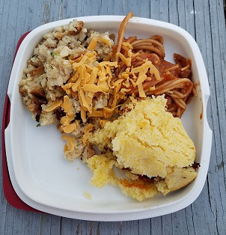
More Ideas
Competition
Themes
Foil Packs
Potluck
Put Your Ideas in the Chat
Notes:
Maria’s Brown - Ideas

Slide 38
Global Sustainability – More Information
Helplessness, Anger, Grief?
There are things we can all do!
Learn – Spread the Word
Support businesses/organizations making a difference
Vote!
UN Sustainable Development Goals
https://www.unep.org/explore-topics/sustainable-development-goals
Gates Foundation
Notes:
Surveys have shown that youth may have Sense of helplessness, anger at the state
Older - grief, … I’m trapped in our society’s way of doing things.
There are things we can do!
Learn all you can – spread the word
VOTE!
Support green businesses, organizations working toward SDGs
The even bigger picture – UN Sustainable Development Goals 17 key areas
https://www.unep.org/explore-topics/sustainable-development-goals

Slide 39
Summary
Meals are part of the Fun and Adventure
Keys to ensuring our Meals are “Leave No Trace”
  Planning and Preparation
  Leave No Trace Awareness, Principles, Practices
Lots of ideas for meals, ways to organize them
Other ideas & tips

Slide 40
Thanks for Attending!
Please fill out Survey – We appreciate your feedback!
Contact us:
  Mark: meh@LPBroadband.net
  Roundtable@OutdoorEthics-BSA.org
Video, Presentation, and Resources will be posted to
Roundtables on OutdoorEthics-BSA.org
Thanks to our Roundtable Workgroup for organizing these OE Roundtables!
Notes:
Thanks to our Roundtable Workgroup for organizing these OE Roundtables!

