Slide 1
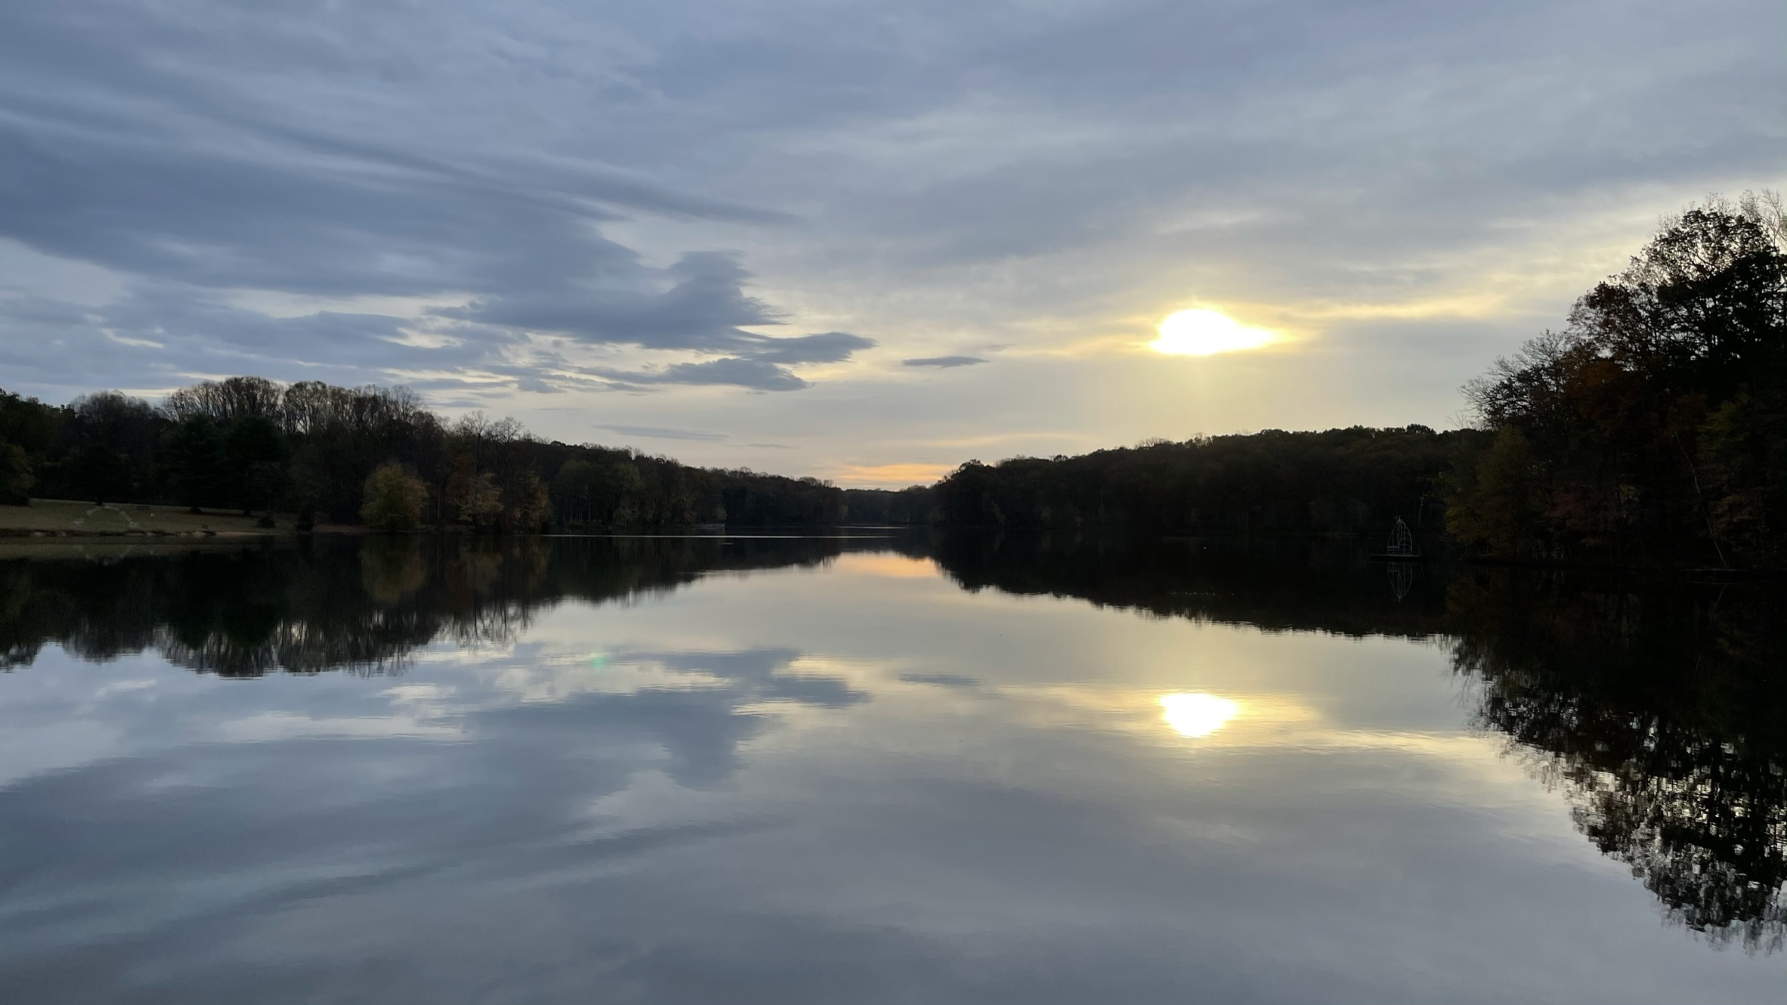
Teaching OE Online – Resources
Paul Schimke, National Capitol Area Council OE Committee Leave No Trace Maryland State Advocate November 1, 2020

Slide 2
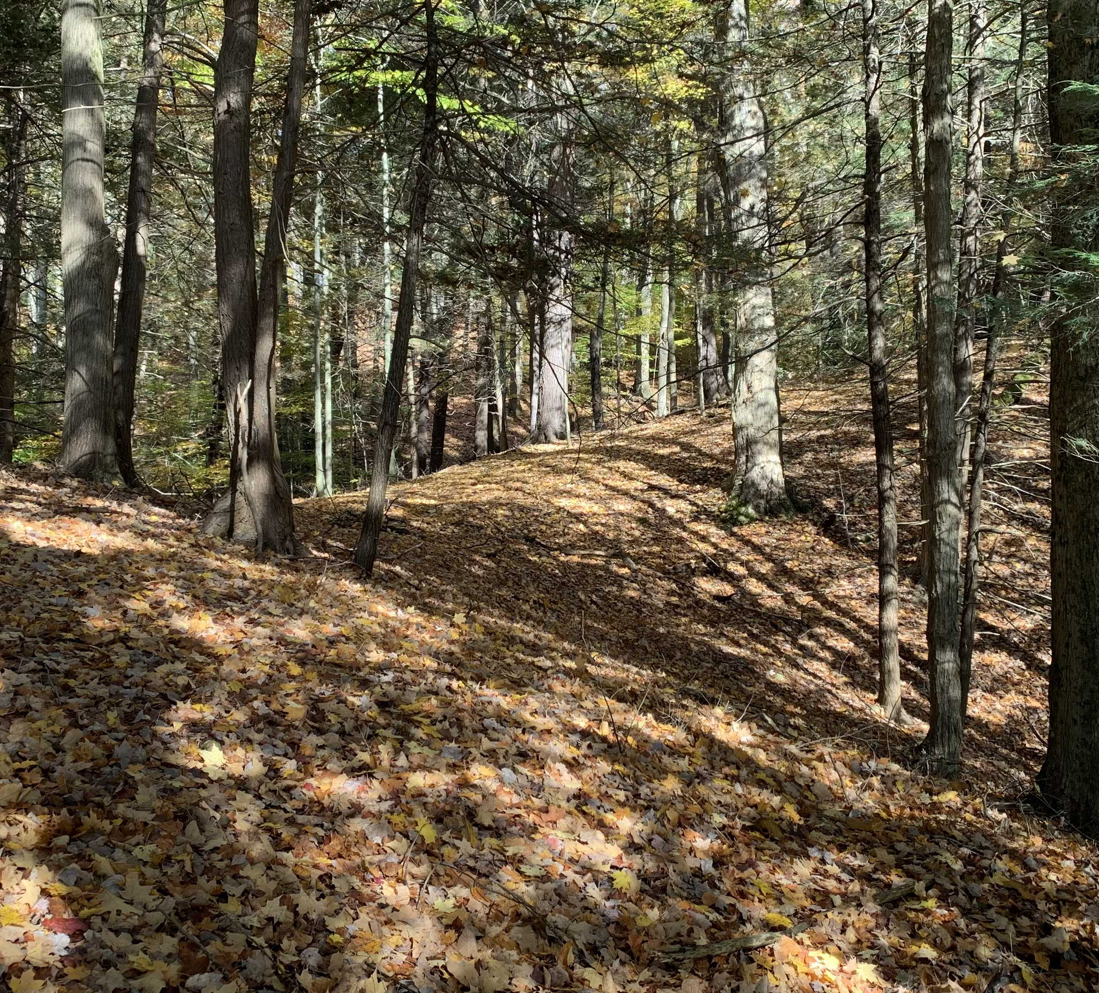
Center Resources
Youth Educator Library
Search lnt.org for “covid”
Resources for Parents, Educators, and Youth Programs
Virtual Trainer Course Model (page 6ff)
Center YouTube channel

Slide 3
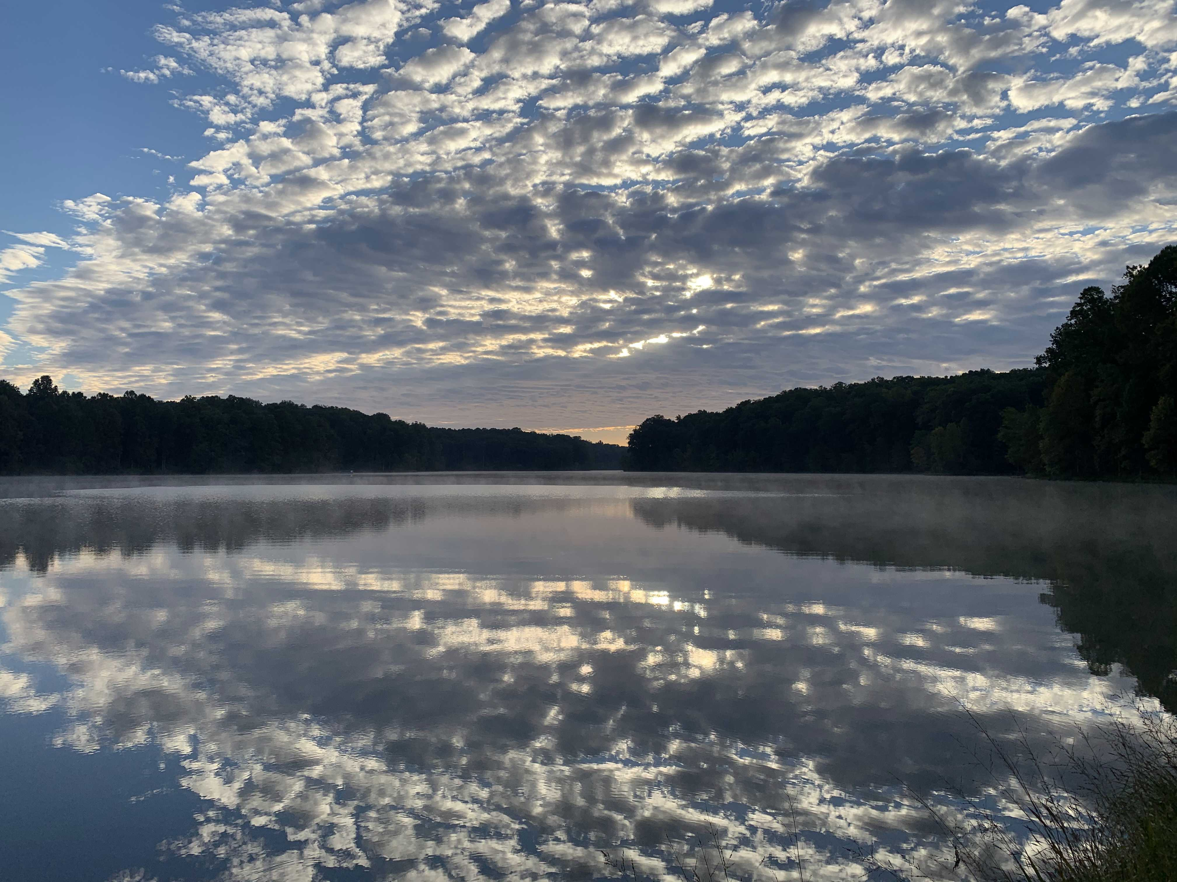
Contact us
Paul Schimke (mdadvocate@lnt.org)
Matt Durrant (mtybumpo@gmail.com)
Paula Boothe (towonuni@aol.com)
Chandra Clark (lakeviewlnt@gmail.com)

