Slide 1
BSA Guide to Safe Scouting in a Digital World

Slide 2
BSA Guide to Safe Scouting in a Digital World
Goal:
Brief discussion of BSA Guidelines and Resources
Objectives:
Where to find BSA Digital Safety and on-line Activities Guidelines.
Know what Safety Moments are and where to find them.
Special considerations for youth.

Slide 3
Guide to Safe Scouting

Slide 4
Guide to Safe Scouting

Slide 5
Safety Moments

Slide 6
Safety Moment for the Land

Slide 7
As an American, I will do my best to –
Be Clean in my outdoor manners.
A Cub Scout takes care of the outdoors and keeps the outdoors clean. A Cub Scout knows that putting marks on buildings, trees, or natural objects causes permanent damage.

Slide 8
Be Careful with fire.
A Cub Scout may enjoy a campfire only with adult leaders. A Cub Scout knows not to play with matches and lighters.

Slide 9
Be Considerate in the outdoors.
A Cub Scout shares our outdoor places and treats everything on the land and in the water with respect.

Slide 10
Be Conservation-minded.
A Cub Scout works to restore the health of the land so others may enjoy, live, and learn from it as a part of the Web of Life.

Slide 11
Digital Safety and Online Scouting
Last Update April 22, 2020

Slide 12
Digital Safety and Online Scouting
All youth protection policies still apply in an online environment.
Use business-oriented conference platforms that include good safety and privacy features.
Regularly review and implement the latest security features of your chosen platform.

Slide 13
Digital Safety and Online Scouting
Do not record online activities/meetings that include youth participants.
Safeguard personal information for adults and youth.
- Do not use nicknames.
        First name only when youth visible during a meeting.
        Reminder: 2-deep leadership applies to emails
        (best to cc a parent).
        BCC all participants.
Collecting personal information from youth under 13 is not recommended.
        - Do not share rosters without expressed permission from everyone on the list. Parents to give permission for youth.

Slide 14
BSA Social Media Guidelines

Slide 15
BSA Social Media Playbook

Slide 16
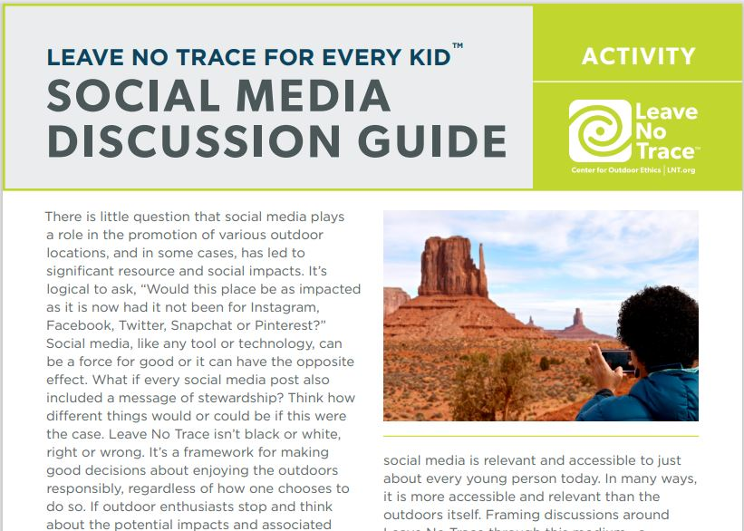
Leave No Trace Social Media Discussion Guide

Slide 17
Objectives:
- Where to find BSA Digital Safety and on-line Activities Guidelines.
- Know what Safety Moments are and where to find them.
- Special considerations for youth.

