Slide 1
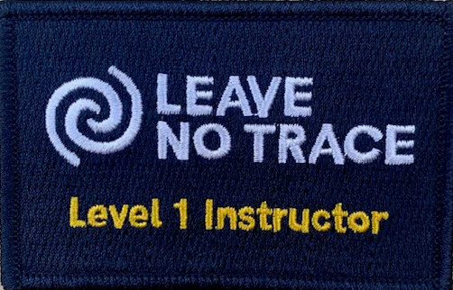
Notes:
Props:
Flip charts
Markers
Activity: Ethics Game

Slide 2
Leave No Trace Level 1 Instructor
Welcome!
Introductions
Housekeeping items
Overall schedule for training
Notes:
Introduce yourself
Introduce co-instructor

Slide 3
Introductions
Introduce yourself
Where you are from
Favorite outdoor activity
Familiarly with Leave No Trace
Expectations from this training
Notes:
Use flip chart to record course expectations
Give your own expectations: That everyone will share the Leave No Trace message
Housekeeping items:
Location of key safety items (first aid, fire extinguishers, etc.)
Cell phone numbers for staff
Location of bathrooms
General overview of schedule

Slide 4
Outdoor Ethics
What is a good definition for Outdoor Ethics?
Notes:
How do we define Outdoor Ethics?
Use flip chart to develop a definition of outdoor ethics
Ask participants for their thoughts and ideas
Let’s look at the words one at a time:

Slide 5
Outdoor Ethics
Outdoor:
Notes:
How do we define “Outdoors?”
Everything that is not inside?
Ask participants for their thoughts and ideas

Slide 6
Outdoor Ethics
Outdoor:
Land where public access is allowed
Notes:
Outdoor:
It’s land where public access is allowed
Including Federal lands, such as National Parks, National Forests, BLM
It is our state lands, such as state parks and state forests
It’s local municipal lands, such as parks and town forests
It’s also private lands with public easements
What does this mean for all of us?
We need to play nice and share the resource

Slide 7
Outdoor Ethics
Ethics:
Notes:
How do we define “Ethics?”
Ask participants for their thoughts and ideas

Slide 8
Outdoor Ethics
Ethics:
A set of principles or values that guide behavior
Socially defined obligations over and above our self interests
Culturally shared values that involve notions of right and wrong
Notes:
This is a dictionary definition of ethics
Perhaps think of the doctor’s Hippocratic Oath, or the Scout oath.

Slide 9
Outdoor Ethics
Define ethics for a youth
Notes:
How do you explain or define what is an ethic to a boy or girl?
Ask participants for their thoughts and ideas

Slide 10
Outdoor Ethics
Define ethics for a youth
How you act when you think that you are not going to get caught
Notes:
This is my definition: How you should act when you don’t think that you are not going to get caught.

Slide 11
Outdoor Ethics
How everyone should act while recreating on our public lands
Notes:
Combining the two definitions, this is one way to define “Outdoor Ethics.”
Let’s do an exercise with some “less than Leave No Trace” impacts
Activity: Ethics Game

Slide 13
Revision History
Original – 12/10/2023 – (pl)

