Slide 1
BEFORE WE GET STARTED This session will be recorded. Youth please turn off your cameras.
Welcome to the
Outdoor Ethics Roundtable
Outdoor Ethics at Camporees
Go to PollEv.com/matthewdurra146 or text MATTHEWDURRA146 to 22333 to join
What makes an event a WOW! for you and other scouts?

Slide 2
Notes:
Poll Title: Do not modify the notes in this section to avoid tampering with the Poll Everywhere activity. More info at polleverywhere.com/support Camporee WOW Factor https://www.polleverywhere.com/free_text_polls/J8T48F9XZBHI3mzARAwVM

Slide 3
Agenda
Opening
Safety Moment
Introduction of the Roundtable Staff
Main Presentation –Outdoor Ethics at a Camporee
Created by Michelle Bierstedt, Sioux Council, SD
Presented by National Outdoor Ethics’ Workgroup and Dr Jeff Marion, Virginia Tech
Q&A
Announcements
Closing & Social Time

Slide 4
I pledge allegiance to the Flag of the United States of America, and to the Republic for which it stands, one Nation under God, indivisible, with liberty and justice for all.
Notes:
This message is one parents want to hear. At the end of the day, we want them to feel comfortable enrolling their kids in our programs where they know they are receiving the type of education and training to help them become the best version of themselves.

Slide 5
SCOUT OATH
On my honor I will do my best
to do my duty to God
and my country and to obey the Scout Law;
to help other people at all times;
to keep myself physically strong,
mentally awake, and morally straight.

Slide 6
SCOUT LAW
A Scout is…
Trustworthy, Loyal, Helpful, Friendly,
Courteous, Kind, Obedient, Cheerful,
Thrifty, Brave, Clean,
and Reverent.

Slide 7
Outdoor Code
As an American, I will do my best to
Be clean in my outdoor manners,
Be careful with fire,
Be considerate in the outdoors and
Be conservation-minded.

Slide 8
Safety Moment
Courtesy of Leave No Trace
Back to Basics Wildfire toolkit
Wildfire Safety

Slide 10
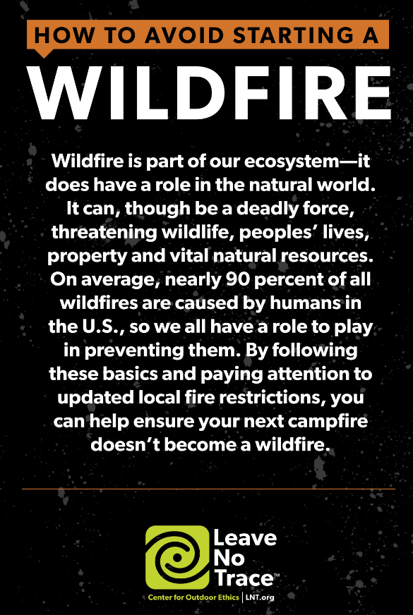

Slide 14
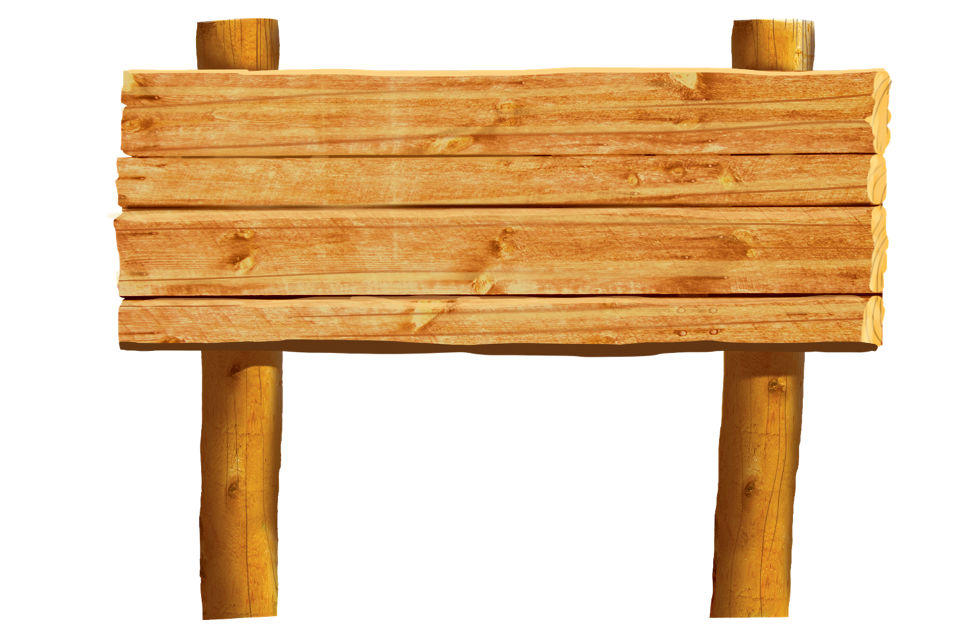
Welcome to Camp
If you have planned or participated in a camporee that had a strong Outdoor Ethics emphasis, make a comment in the chat.

Slide 15
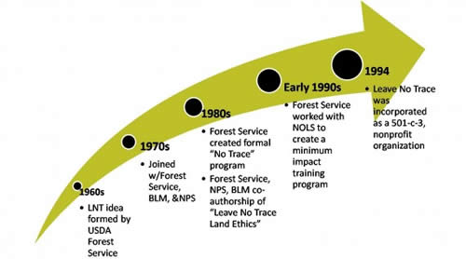
Outdoor Ethics
More than Picking up Trash

Slide 16
Leave No Trace IS NOT a set of rules or regulations.
Leave No Trace IS:
an ethic, an attitude and a set of flexible guiding principles
respecting and caring for wildlands and wildlife
protecting our natural resources and protecting our future recreation opportunities
being considerate of other outdoor users
being prepared and learning minimum impact camping skills
making good decisions whenever we are enjoying outdoor activities
Every outing should be planned and conducted with Leave No Trace in mind!

Slide 17
Making Outdoor Ethics a part of your Camporee…
Minimizing impacts from a large group use, Dr Jeff Marion
Table 1. Direct and indirect effects of recreational trampling on soils and vegetation.
Effects | Vegetation | Soil
Direct | Reduced height/vigor Loss of ground vegetation, shrubs and trees Introduction of non-native vegetation | Loss of organic litter Soil exposure and compaction Soil erosion
Indirect | Altered composition – shift to trampling resistant or non-native species Altered microclimate | Reduced soil pore space and moisture, increased soil temperature Increased water runoff Reduced soil fauna

Slide 18
Rationale for Dispersal & Containment Strategies Use/Impact Relationship
Containment
Impact
Total Change (%)
A concentration / containment strategy is always best for large events
Dispersal
Nights/Year (#)
Notes:
‹#›

Slide 19
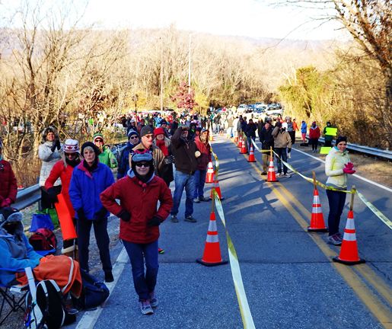
Large Groups: Best Management Practices
Concentrate / contain use to the “footprint” of existing developed and hardened areas with durable surfaces (e.g., pavement, gravel, grass)
Educate or regulate visitors to avoid/minimize impacts
Provide facilities
Schedule to minimize impacts
Avoid sensitive areas
Minimize impacts to visitors
Notes:
‹#›

Slide 20
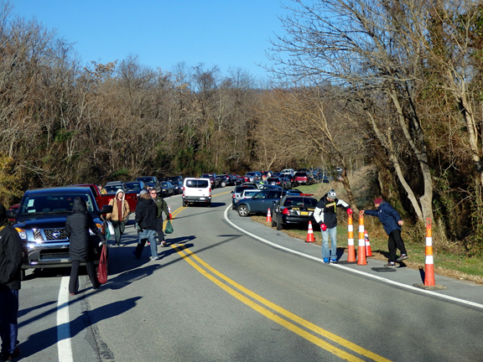
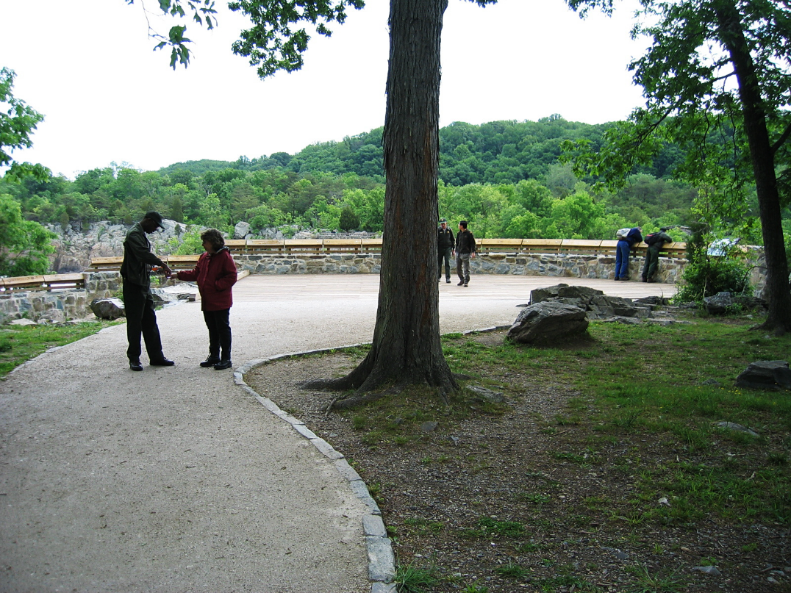
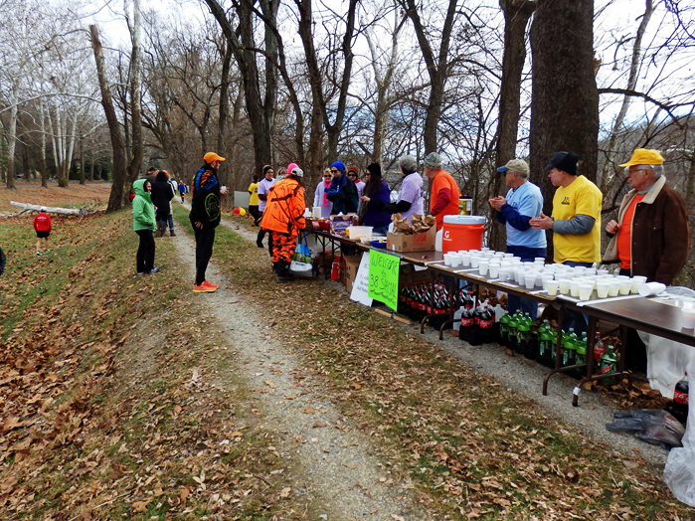
Facility Sustainability
Are the surfaces sufficiently durable?
Consider participant safety…
Notes:
There are three main impacts to natural surfaced trails
Discuss widening and muddiness briefly
Soil loss is the most significant because it is …
Irreversible
Has downstream impacts to water quality and forest productivity,
Impacts the usability of trails (see above)
‹#›

Slide 21
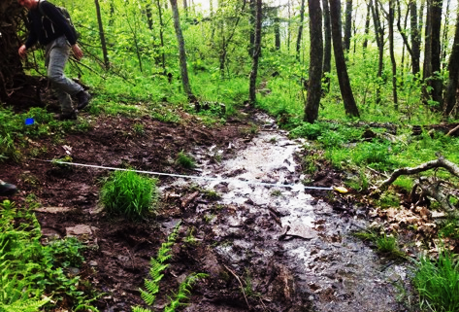
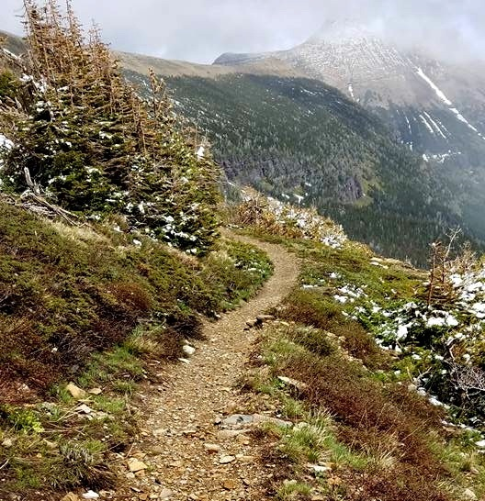
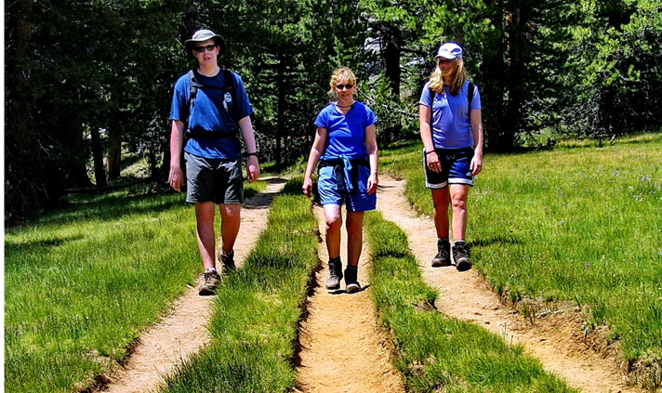
Facility Sustainability
Good
Bad
Notes:
‹#›

Slide 22
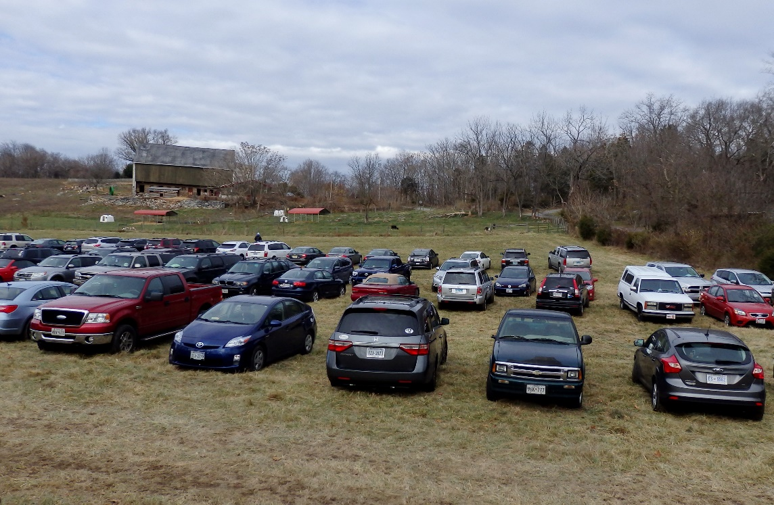
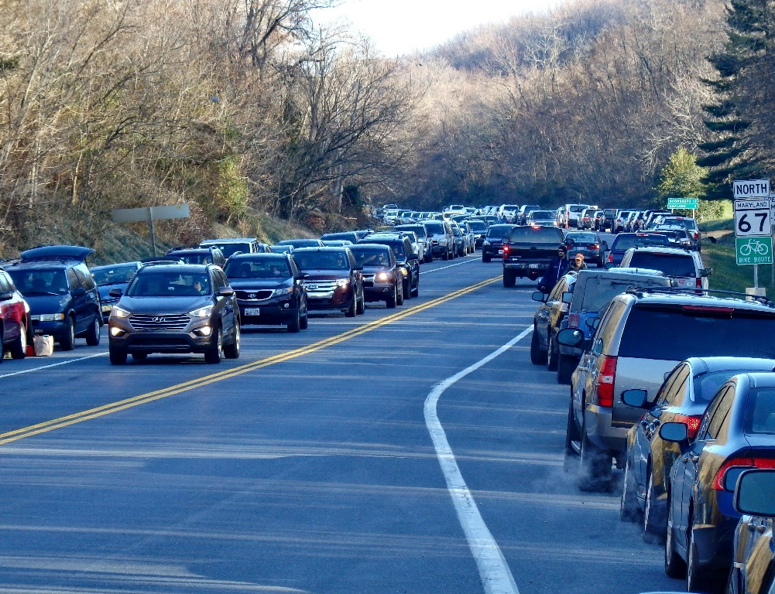
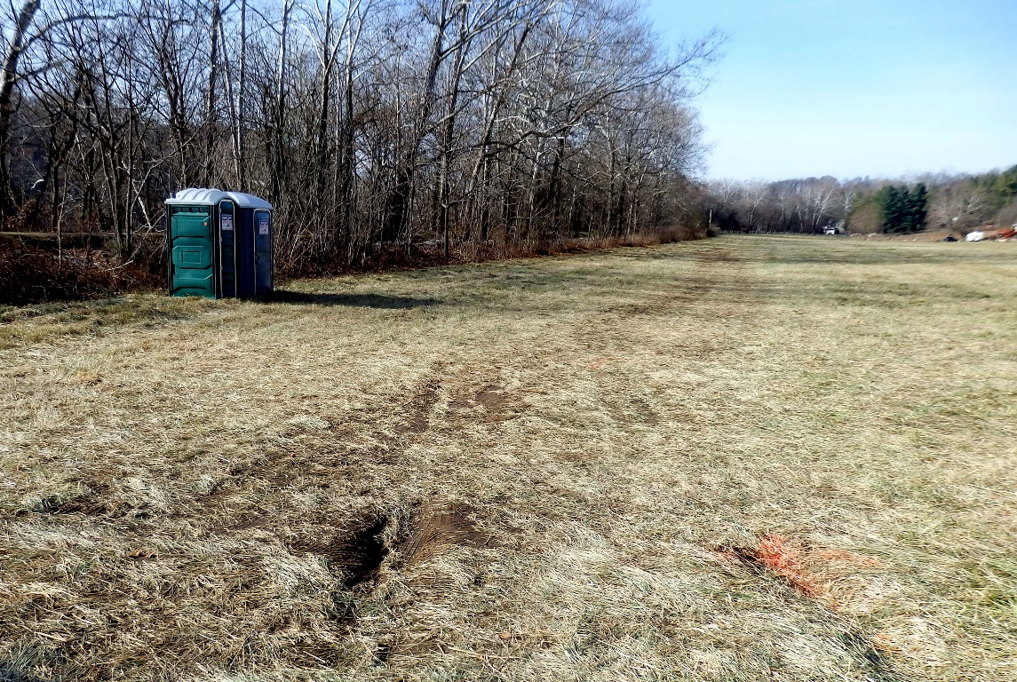
Facility Sustainability
What happens if there is substantial rain?
Notes:
There are three main impacts to natural surfaced trails
Discuss widening and muddiness briefly
Soil loss is the most significant because it is …
Irreversible
Has downstream impacts to water quality and forest productivity,
Impacts the usability of trails (see above)
‹#›

Slide 23
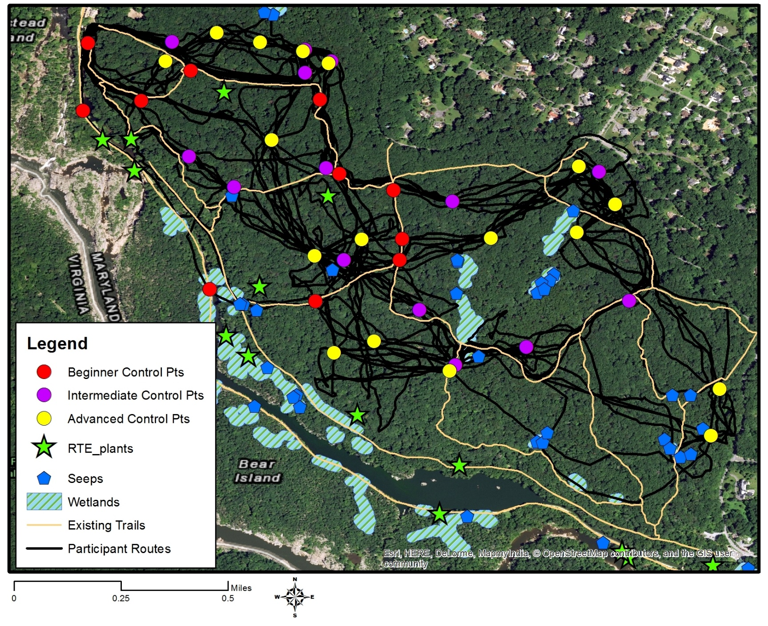
Can a Dispersal Strategy Work?
Orienteering
Notes:
There are three main impacts to natural surfaced trails
Discuss widening and muddiness briefly
Soil loss is the most significant because it is …
Irreversible
Has downstream impacts to water quality and forest productivity,
Impacts the usability of trails (see above)
‹#›

Slide 24
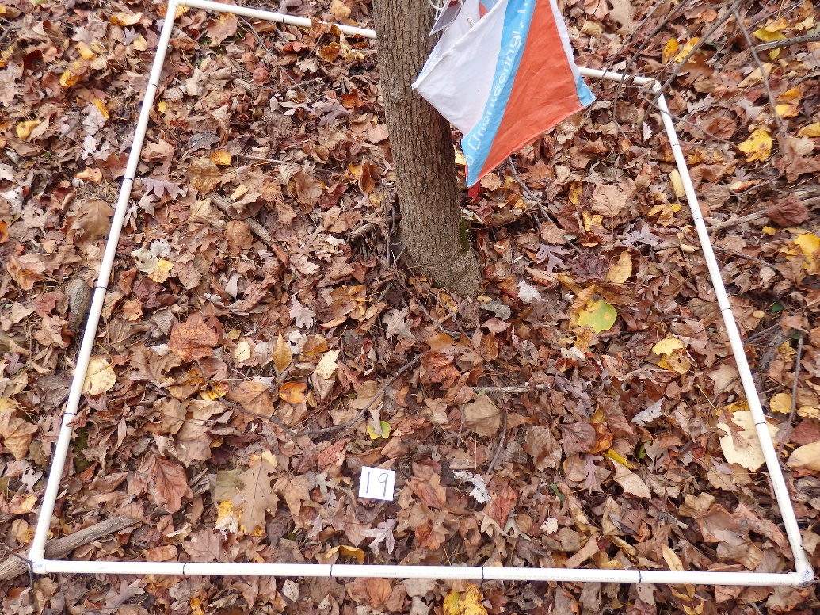
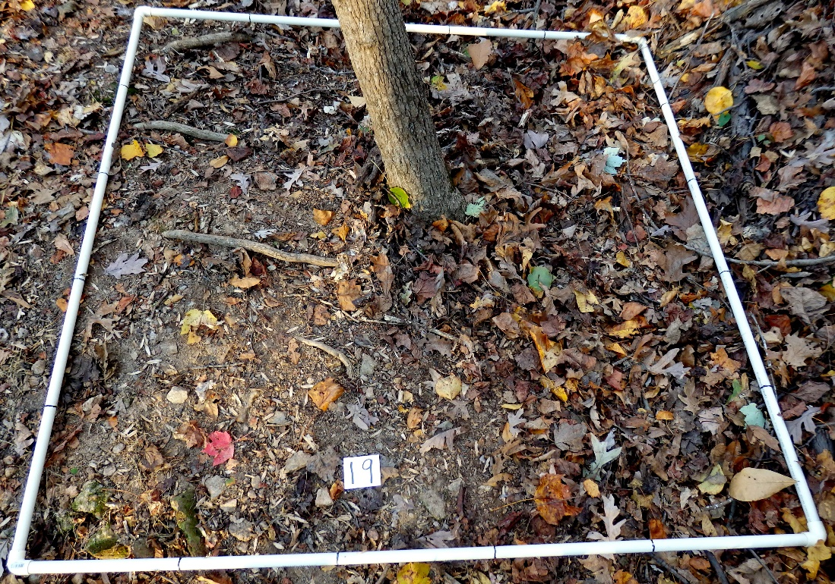
Can a Dispersal Strategy Work?
Event held in the fall after plants had died back but leave litter was significantly pulverized and lost, exposing soil.
Before
After
Notes:
There are three main impacts to natural surfaced trails
Discuss widening and muddiness briefly
Soil loss is the most significant because it is …
Irreversible
Has downstream impacts to water quality and forest productivity,
Impacts the usability of trails (see above)
‹#›

Slide 25
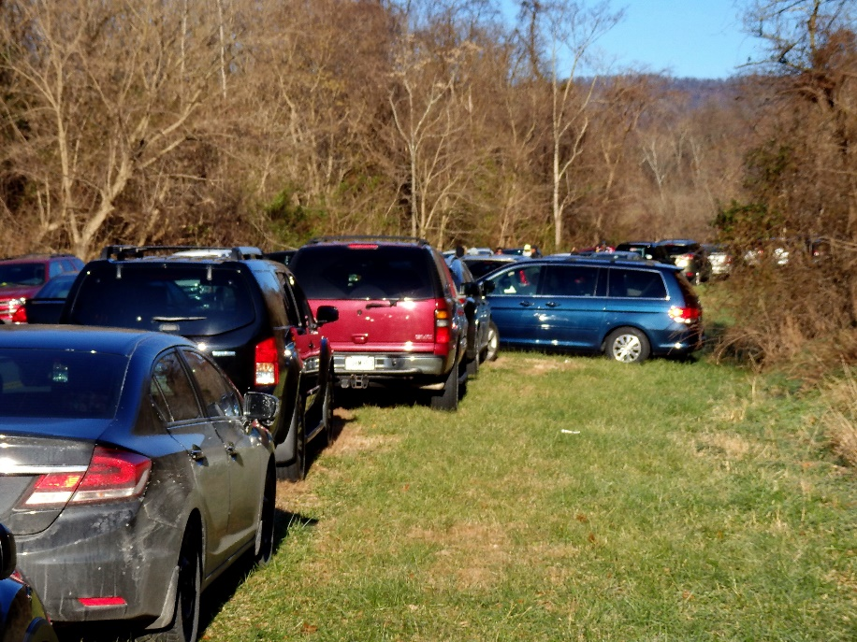
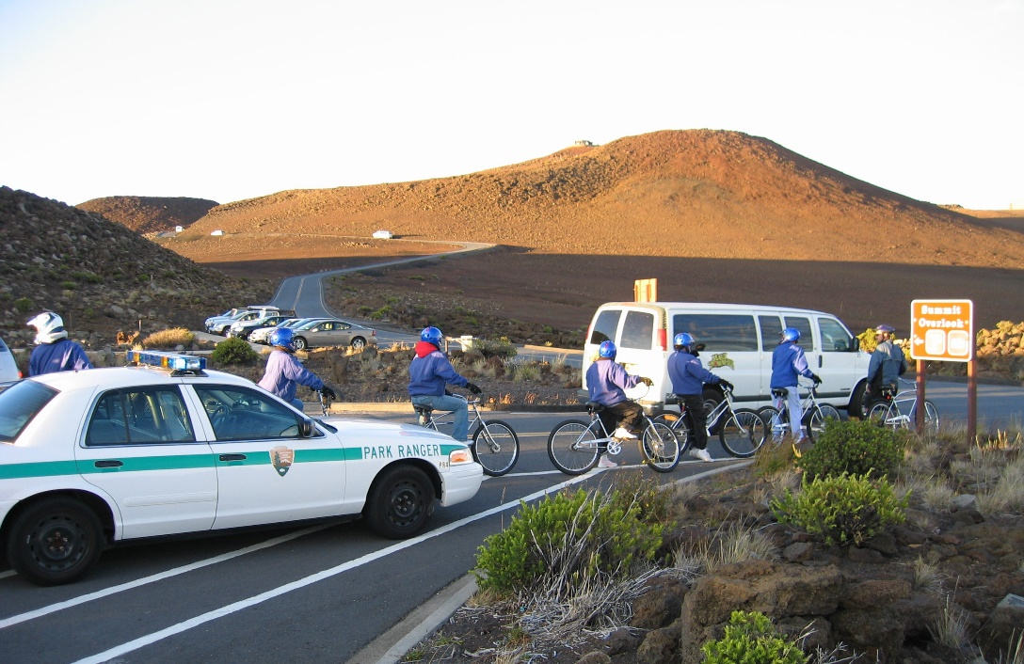
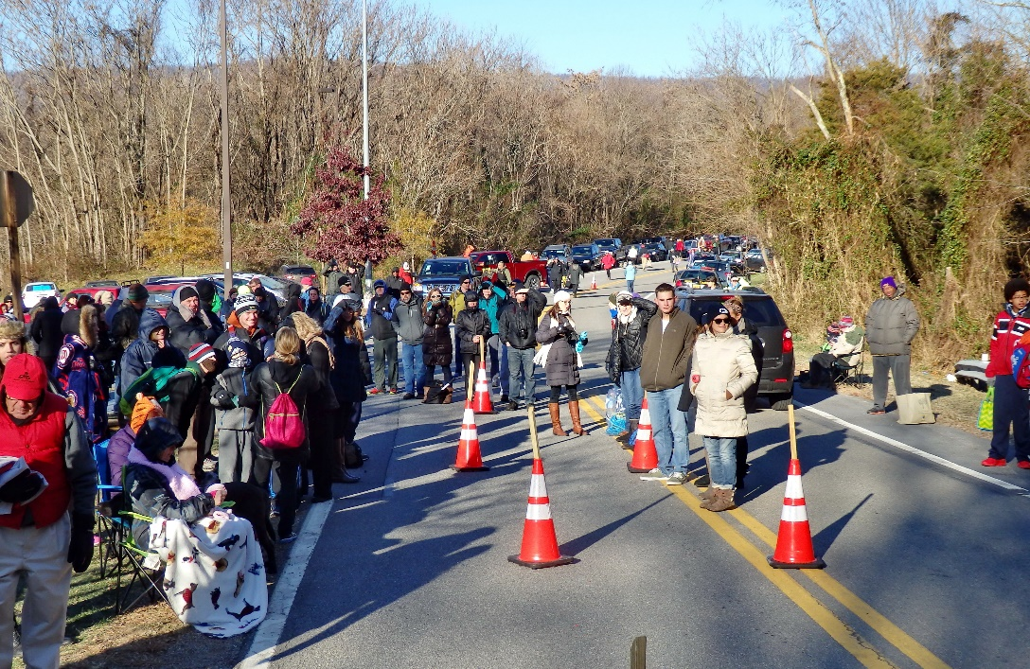
Management Ability/Capacity
Pre-event planning, event management capacity, post-event clean-up and restoration.
Notes:
There are three main impacts to natural surfaced trails
Discuss widening and muddiness briefly
Soil loss is the most significant because it is …
Irreversible
Has downstream impacts to water quality and forest productivity,
Impacts the usability of trails (see above)
‹#›

Slide 26
Date Planner for a Successful Event
12-18 months | 9-12 months | 3-9 months | 1 month –Day of
Camping/Program Committee meets | Turn in the budget | Order any supplies | Walk through the camp final time. Look for hazards or problem areas to avoid.
Choose your theme | Turn in the Leader’s Guide | Check volunteer YPT training | Lay out the camp flow (unit areas and program areas). Create map
Start writing the program book with games and activities promoting Outdoor Ethics and Leave No Trace | Confirm camping area (council property, private camp, or public camp). If needed tour with Short Term NCAP chair for compliance | If an outside resource will have direct contact with youth, start application and YPT as appropriate. | Designate volunteer arrival and setup. Make sure activity supply boxes are complete
Meet with the Short Term NCAP Chair | Open registration, Promotions | Provide program training to volunteers | Designate campsites to units based on capacity. Designate minimum impact areas.
 | Work with volunteers to run the event. |  | Set up a time with Short Term NCAP chair for inspection

Slide 28
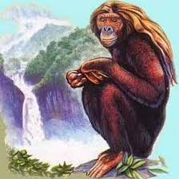
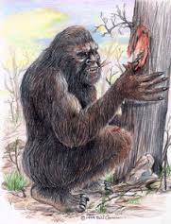
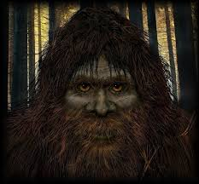
Sasquatch Around the World
Local legend from Columbia, Pennsylvania speak of a creature called an Albatwitch. The Albatwitch is a small, 4 ft tall, manlike creature who lives in wooded areas along the banks of the Susquehanna River. The name “Albatwitch” is short for “apple snitch”, as they have a taste for apples. The creature lives in trees, coming down only to find food
The Lakota, or western Sioux, call Bigfoot Chiye-tanka (Chiha-tanka in Dakota or eastern Sioux); "chiye" means "elder brother" and "tanka" means "great" or "big".
Reported from the island of Sumatra in Indonesia, the orang-pendek is described a red-furred bipedal ape-man about four feet tall.
The Honey Island Swamp Monster is a legendary creature from the Honey Island Swamp, Louisiana. The creature is described as bipedal, 7 feet (2 m) tall, with gray hair and yellow or red eyes, and accompanied by a disgusting smell.
A Bigfoot like creature believed to wander the mountainous tropical countryside of Chile and Argentina. Described to be about the size of a large dog that walks on two legs, the Ucumar is said by natives to eat payo
The Himalaya Mountains, the highest range on Earth, have been referred to as the "roof of the world." If that is so, there is a mystery called the Yeti in our attic. In Tibetan the word means "magical creature”.

Slide 29
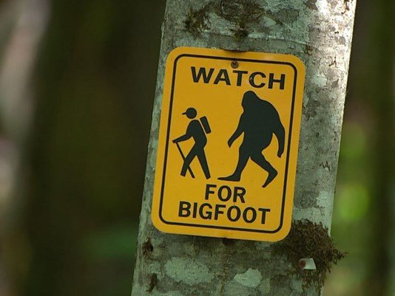
Outdoor Ethics Themed Camporee
You don’t have to cover every principle in a camporee.
Games with a Purpose
Big Foot Bootcamp
Zombie Apocalypse
Leave No Trace Everyday
Walk with Sasquatch
The Amazing Race (https://bsa344.com/Camporee%20-%20Amazing%20Race.pdf)
Are You Prepared?
Surviving the Ice Age winter camporee (https://bsa344.com/Surviving_the_Ice_Age.html)

Slide 30
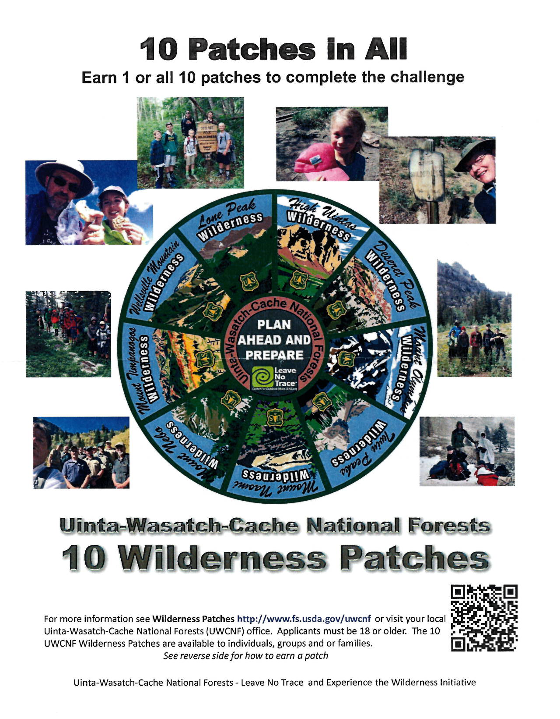
Partnerships!
You can get local land managers to help at camporees.
They have great ideas and resources.
Most of the time they are more than willing to help you or at least let you use some of their resources.

Slide 31
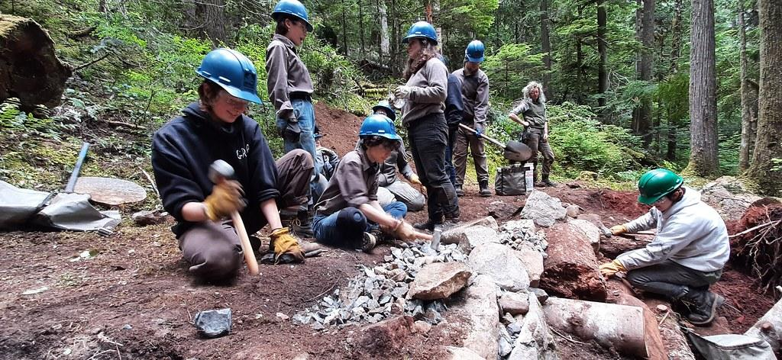
For Adults and Older Scouts
Leave No Trace Trainer Course (need a Master Educator)
BSA - Leave No Trace 101 Course
Outdoor Ethics Orientation Course
Outdoor Ethics Action Award

Slide 32
EXAMPLE
Plan Ahead and Prepare – Map Reading | Dispose of Waste Properly – What to do with Poo | Leave What You Find – Unlock the Past | Respect Wildlife – “Please don’t feed the Bear”
101 ways to teach Leave No Trace –activity 036 The Perils of Poor Planning | Use a rope to determine 200 feet for waste disposal. See who can get closest to the mark. | 101 ways to teach Leave No Trace –activity 072 Archeological Dig | Learn how to keep food and supplies secure. What is a bear container?
Basic topographic and camp map reading skills. Review compass and gps use. Develop a written plan for a hike or camp experience | Learn how to dig a cathole and when you would need to use it. | 101 ways to teach Leave No Trace –activity 073 Before and After | Review the Thumb Rule for respecting wildlife
Points activity: Orienteering Course | Points activity: Campsite Inspection | Points activity: What would you do? Type an idea in the chat | Points activity: Practice hanging a bear bag.

Slide 33
Travel and Camp on Durable Surfaces – Durable vs Non-Durable Surfaces | Minimize Impact – Small Impact fires | Be Considerate of Others – Nature Photography
Big Foot Playbook activity –Satellite Trails | Make Fire strings – 18” twine (3 per person), melted wax, pony bead. Scouts pull the 3 pieces of twine through the pony bead. Braid to the end. Dip in melted wax. To use, cut off a section. Fray one end a little bit and light to help start a fire. | Take a hike with a photographer. Learn how to get the “perfect shot” without disturbing nature or other visitors
Big Foot Playbook activity –Watch your step or Durable Surface Mystery | Big Foot Playbook activity –Campfire Impact Game | Big Foot Playbook activity – Quiet on the set
Points Activity What would you do? Type an idea in the chat | Points Activity Big Foot Playbook activity – Mound Fire Mania | Points Activity Big Foot Playbook activity – Fort Building

Slide 34
Resources
Additional Resources
https://filestore.scouting.org/filestore/Outdoor%20Program/pdf/430-001.pdf
http://outdoorethics-bsa.org/resources/
http://usscouts.org/usscouts/camporees.asp
Leave No Trace Center for Outdoor Ethics
Lnt.org
Bigfoot’s Playbook
101 Ways to Teach Leave No Trace
Teaching Leave No Trace Activity Guide
PEAK Pack materials
https://lnt.org/our-work/youth-education/
Examples of Leader’s Guide
https://www.danielboonecouncil.org/files/22985/TTC-Leader-Guide-pdf-pdf
https://www.scoutingvermont.org/uploads/4/7/2/2/47226097/2019_fall_camporee_-_scouting_olympics.pdf

Slide 35
Possible Awards for Campers and Units
Big Foot Award: by earning points at stations. For scouts or units
Big Foot camouflage costume or Big Foot Skit: for units
Forester Award: service project participant
Bright Idea Award: for scouts or units that have an innovative idea on minimizing camp impacts.
BSA Awards
Outdoor Ethics Award and Outdoor Ethics Action Award

Slide 36
Q&A
Ideas to share… type ideas into the chat or raise your hand for a minute to talk about your idea.

Slide 37
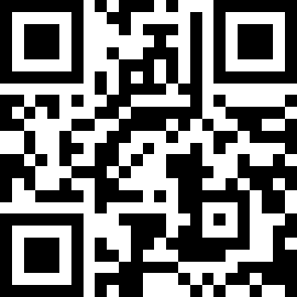
Feedback is a gift
Please take a minute to share your feedback. It really does make a difference!
https://tinyurl.com/oertjun21

Slide 38
Announcements

Slide 39
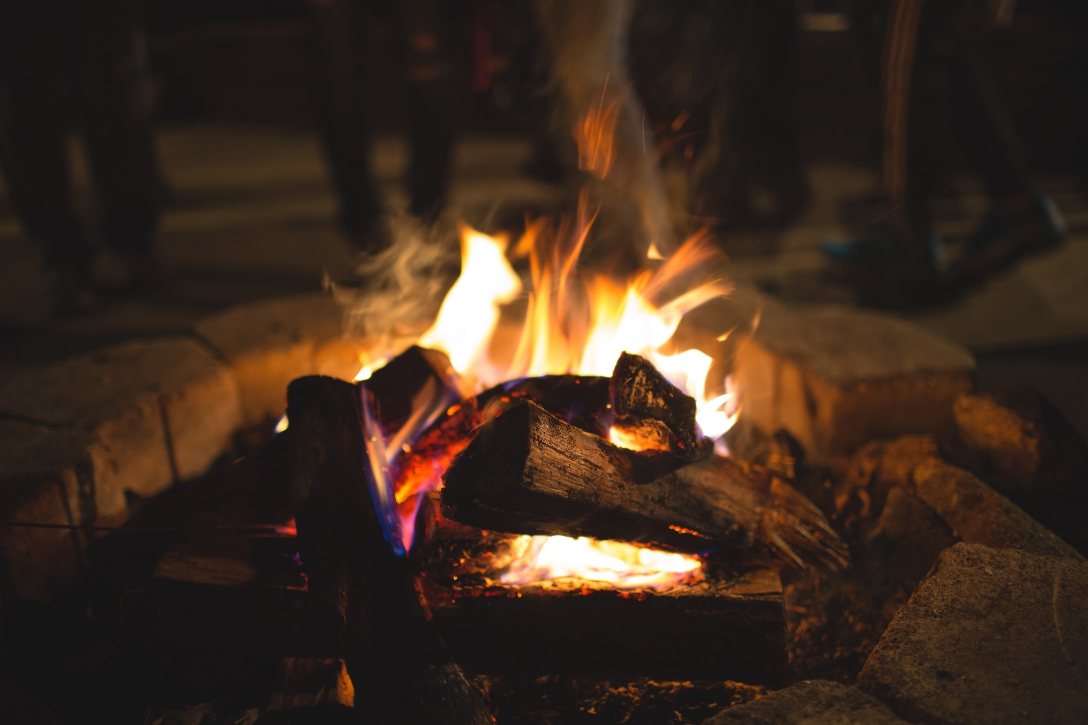
Social Time

